Slide 1
Classes and Objects: A Deeper Look
Chapter 10 of Visual C# How to Program, 6/e

Slide 2
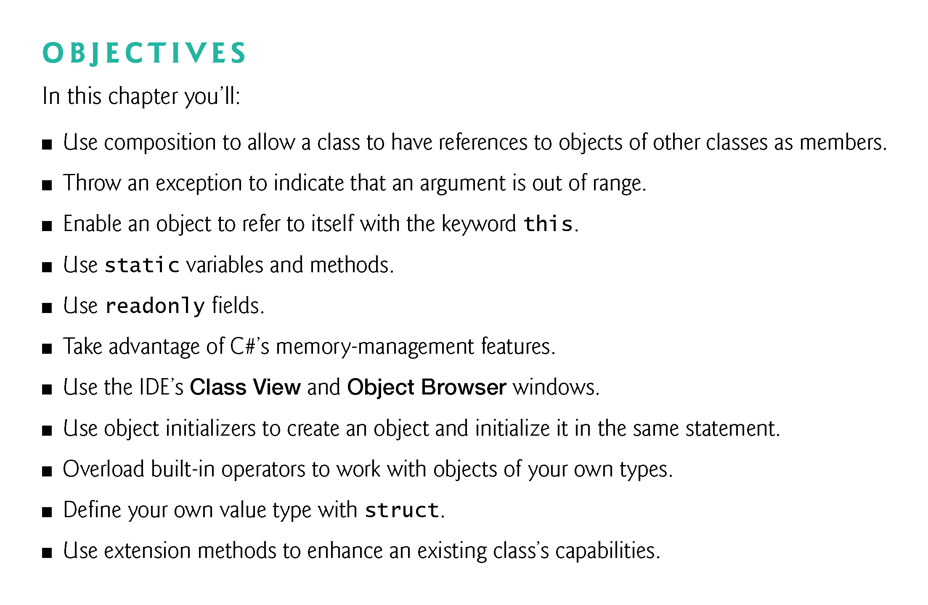

Slide 3
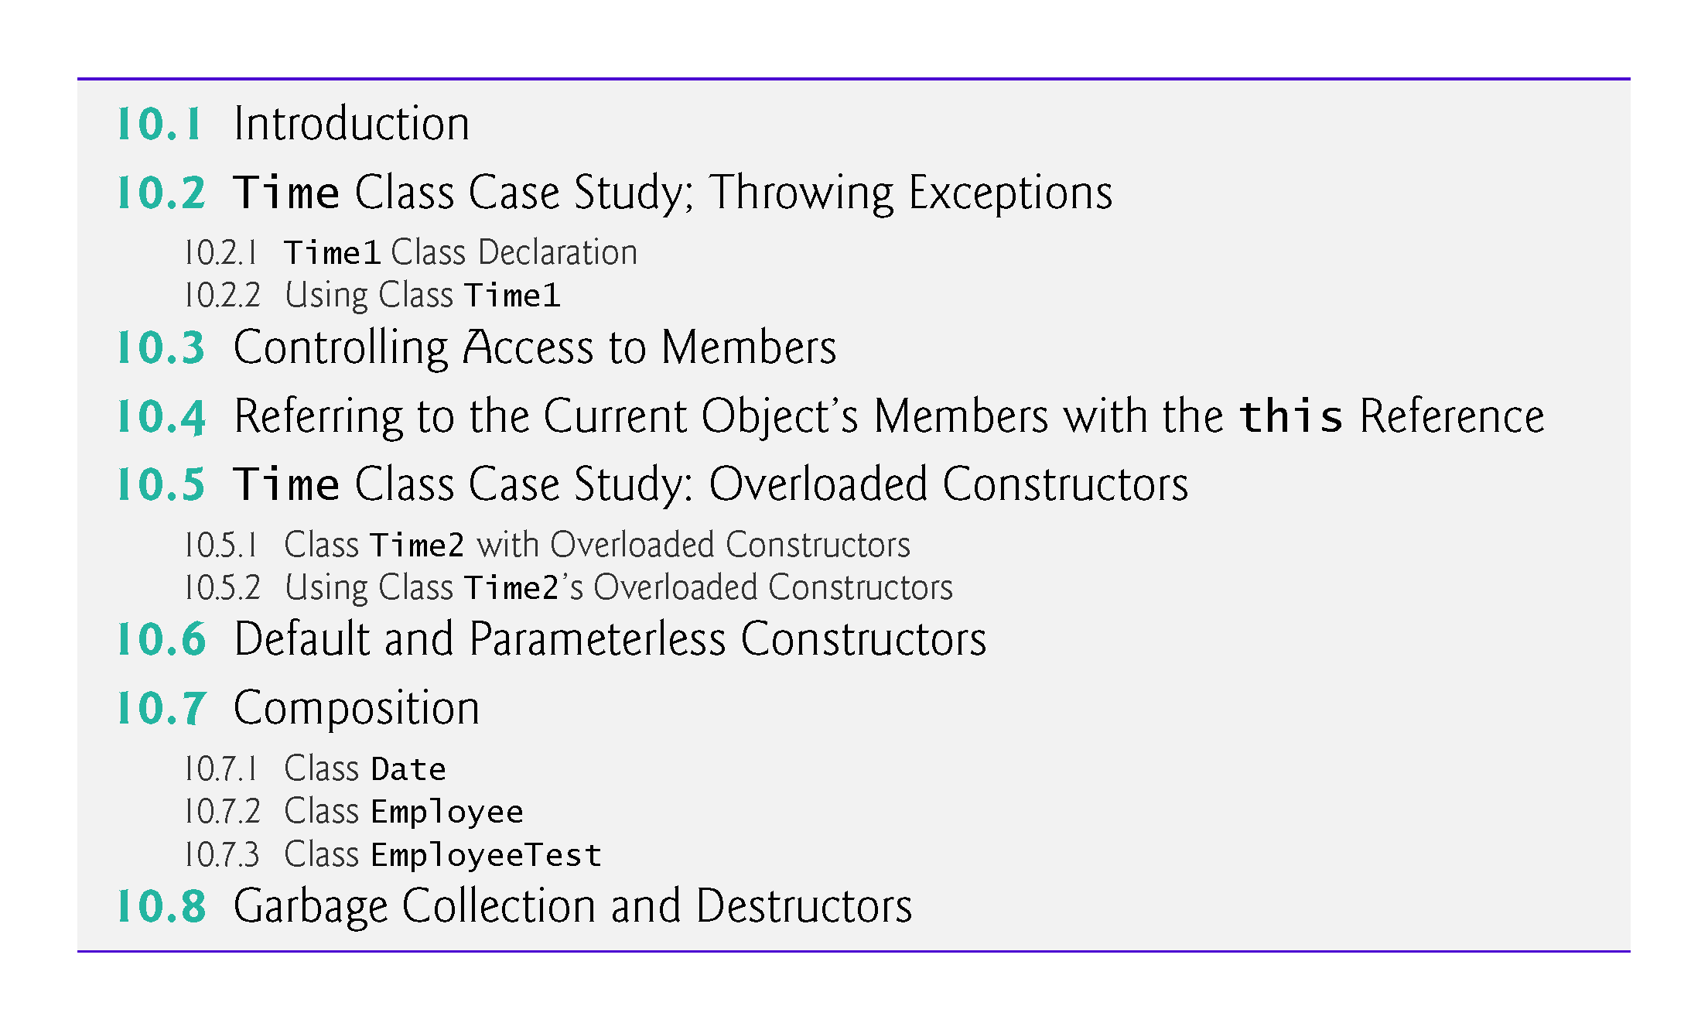

Slide 4
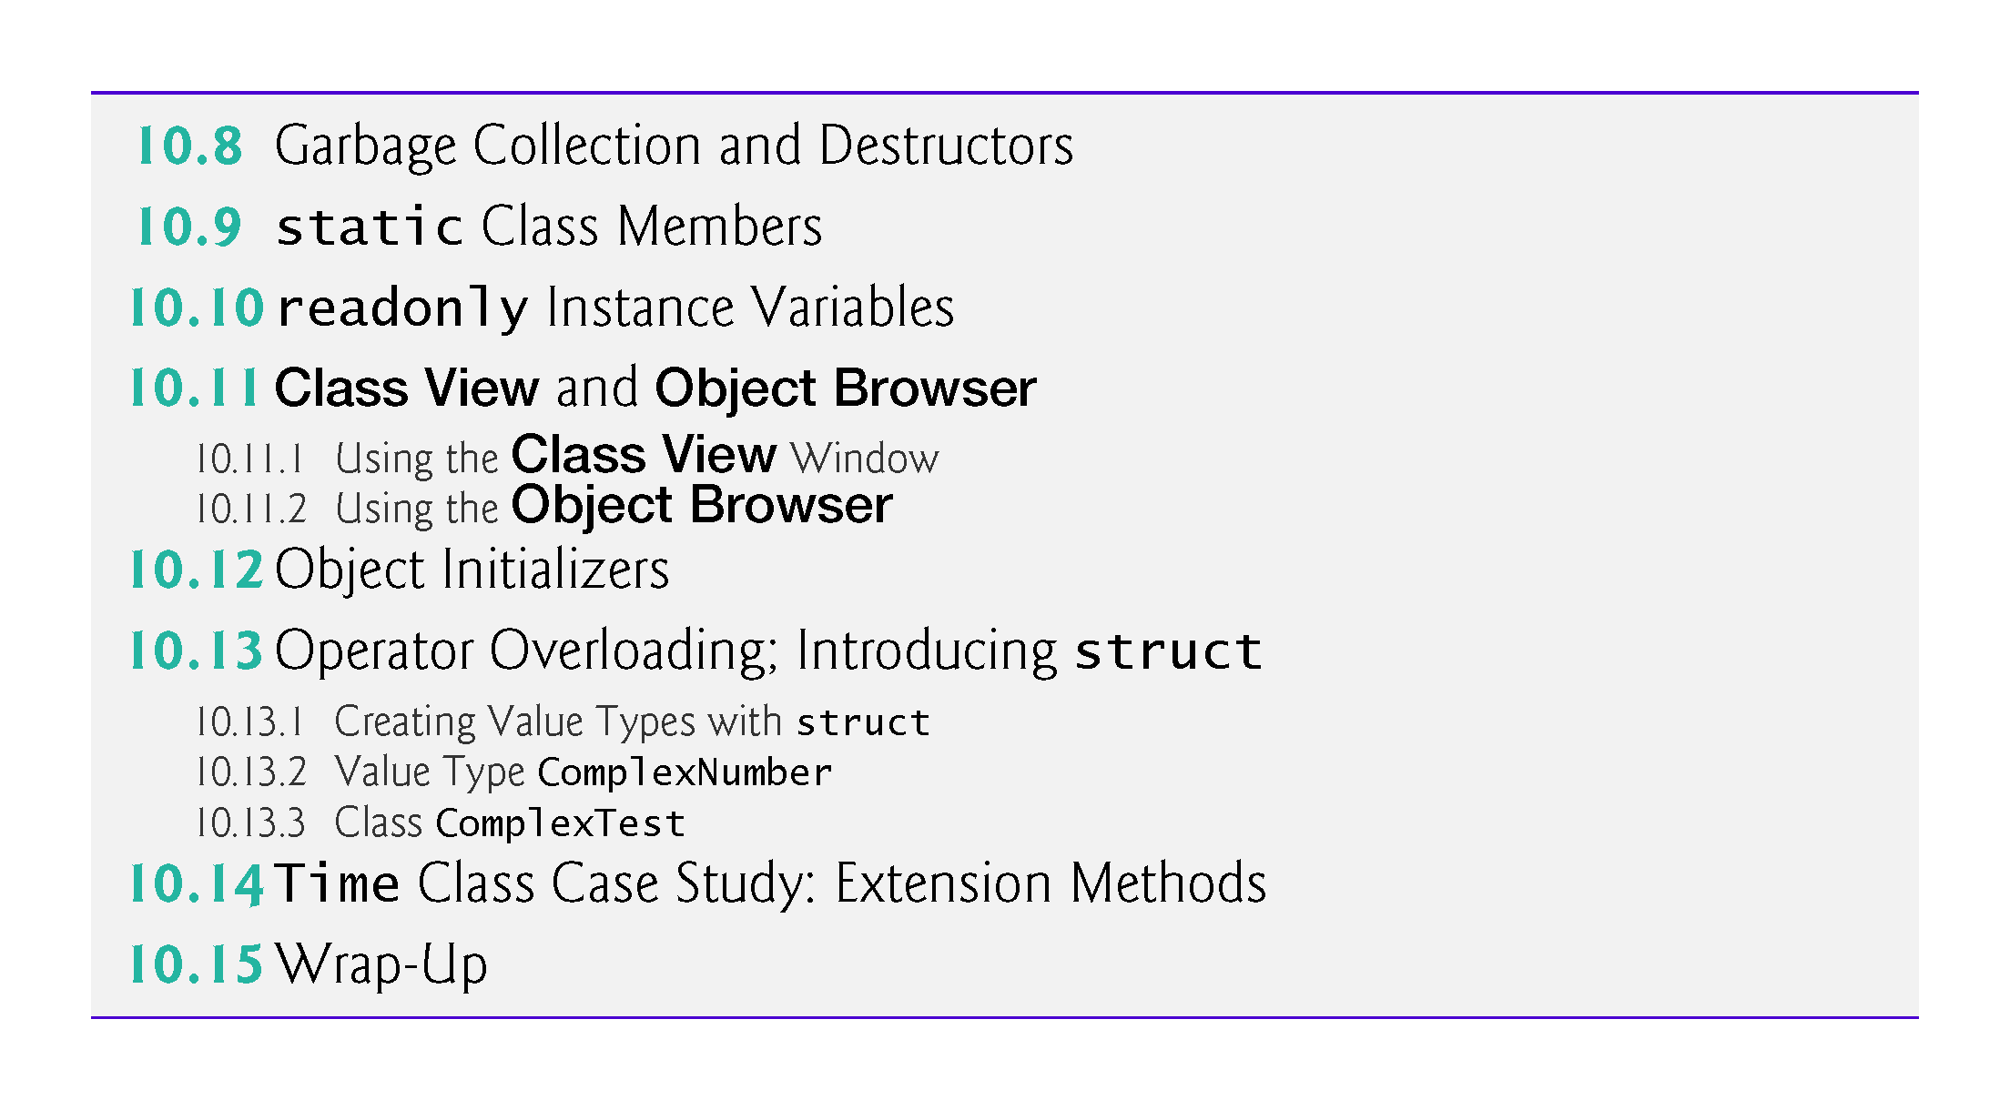

Slide 5
10.2 Time Class Case Study; Throwing Exceptions
Class Time1 (Fig. 10.1) represents the time of day.
The class contains public properties for the Hour, Minute and Second.
A class’s public members are the public services or the public interface that this class provides to its clients.
Time1 does not declare a constructor, so the compiler defines a default constructor.
Each property receives the default value 0 for an int.
Instance variables and auto-implemented properties also can be assigned values in their declarations

Slide 6
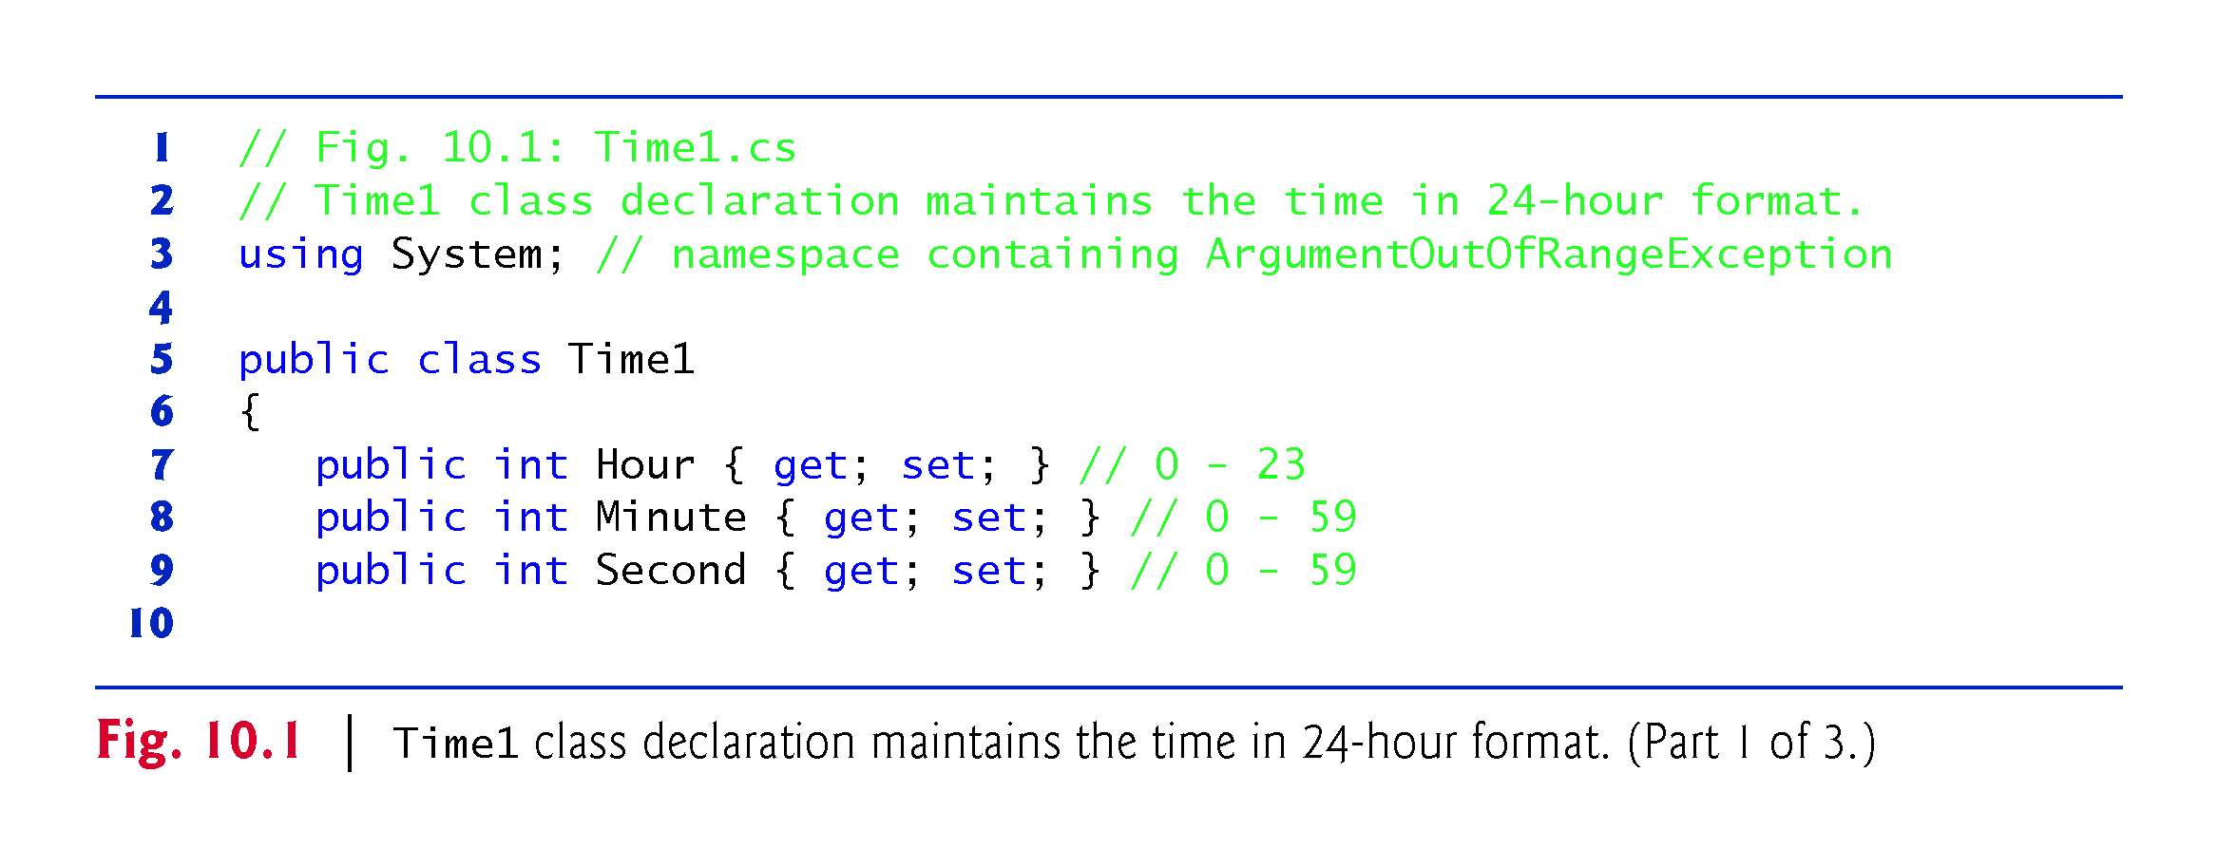

Slide 7
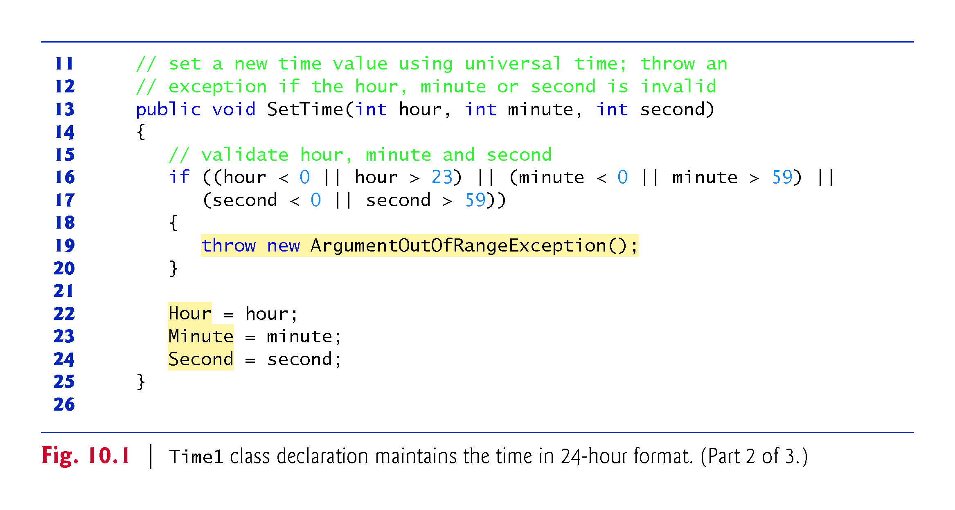

Slide 8
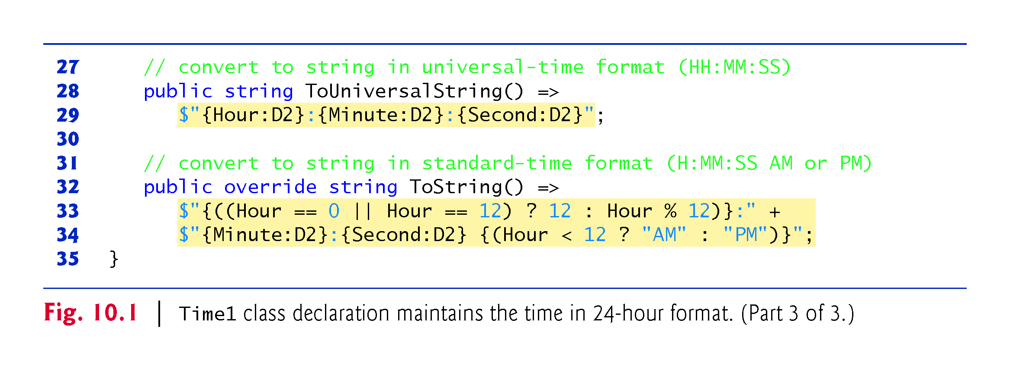

Slide 9
10.2 Time Class Case Study (Cont.)
public Class
Time1 is a public class—it can potentially can be reused in other projects.
Although we use class Time1 only in this project, from this point forward, we’ll declare as public any class that could potentially be reused in another project.

Slide 10
10.2 Time Class Case Study (Cont.)
Method SetTime and Throwing Exceptions
Method SetTime is a public method that declares three int parameters and uses them to set the time.
Lines 16–17 test each argument to determine whether the value is out of range. If not, lines 22–24 assign values to the propertoes.
The hour value must be greater than or equal to 0 and less than 24, because universal-time format represents hours as integers from 0 to 23 (e.g., 1 PM is hour 13 and 11 PM is hour 23; midnight is hour 0 and noon is hour 12).

Slide 11
10.2 Time Class Case Study (Cont.)
Both minute and second values must be greater than or equal to 0 and less than 60.
For values outside these ranges, SetTime throws an ArgumentOutOfRangeException, which notifies the client code that an invalid argument was passed to the method.
The throw statement creates a new object of type ArgumentOutOfRangeException.
The parentheses following the class name indicate a call to the ArgumentOutOfRangeException constructor.

Slide 12
10.2 Time Class Case Study (Cont.)
After the exception object is created, the throw statement immediately terminates method SetTime and the exception is returned to the code that attempted to set the time.

Slide 13
10.2 Time Class Case Study (Cont.)
Method ToUniversalString
Method ToUniversalString is an expression-bodied method
The method takes no arguments and returns a string in universal-time format, consisting of six digits—two for the hour, two for the minute and two for the second.
The D2 format specifier formats an integer with two digits and, where needed, a leading 0 if the integer has fewer than two digits.

Slide 14
10.2 Time Class Case Study (Cont.)
Method ToString
Method ToString (lines 32–34) is an expression-bodied method that takes no arguments and returns a string in which the Hour, Minute and Second values are separated by colons and followed by an AM or PM indicator (e.g., 1:27:06 PM).

Slide 15
10.2 Time Class Case Study (Cont.)
The Time1Test app class (Fig. 10.2) uses class Time1.

Slide 16
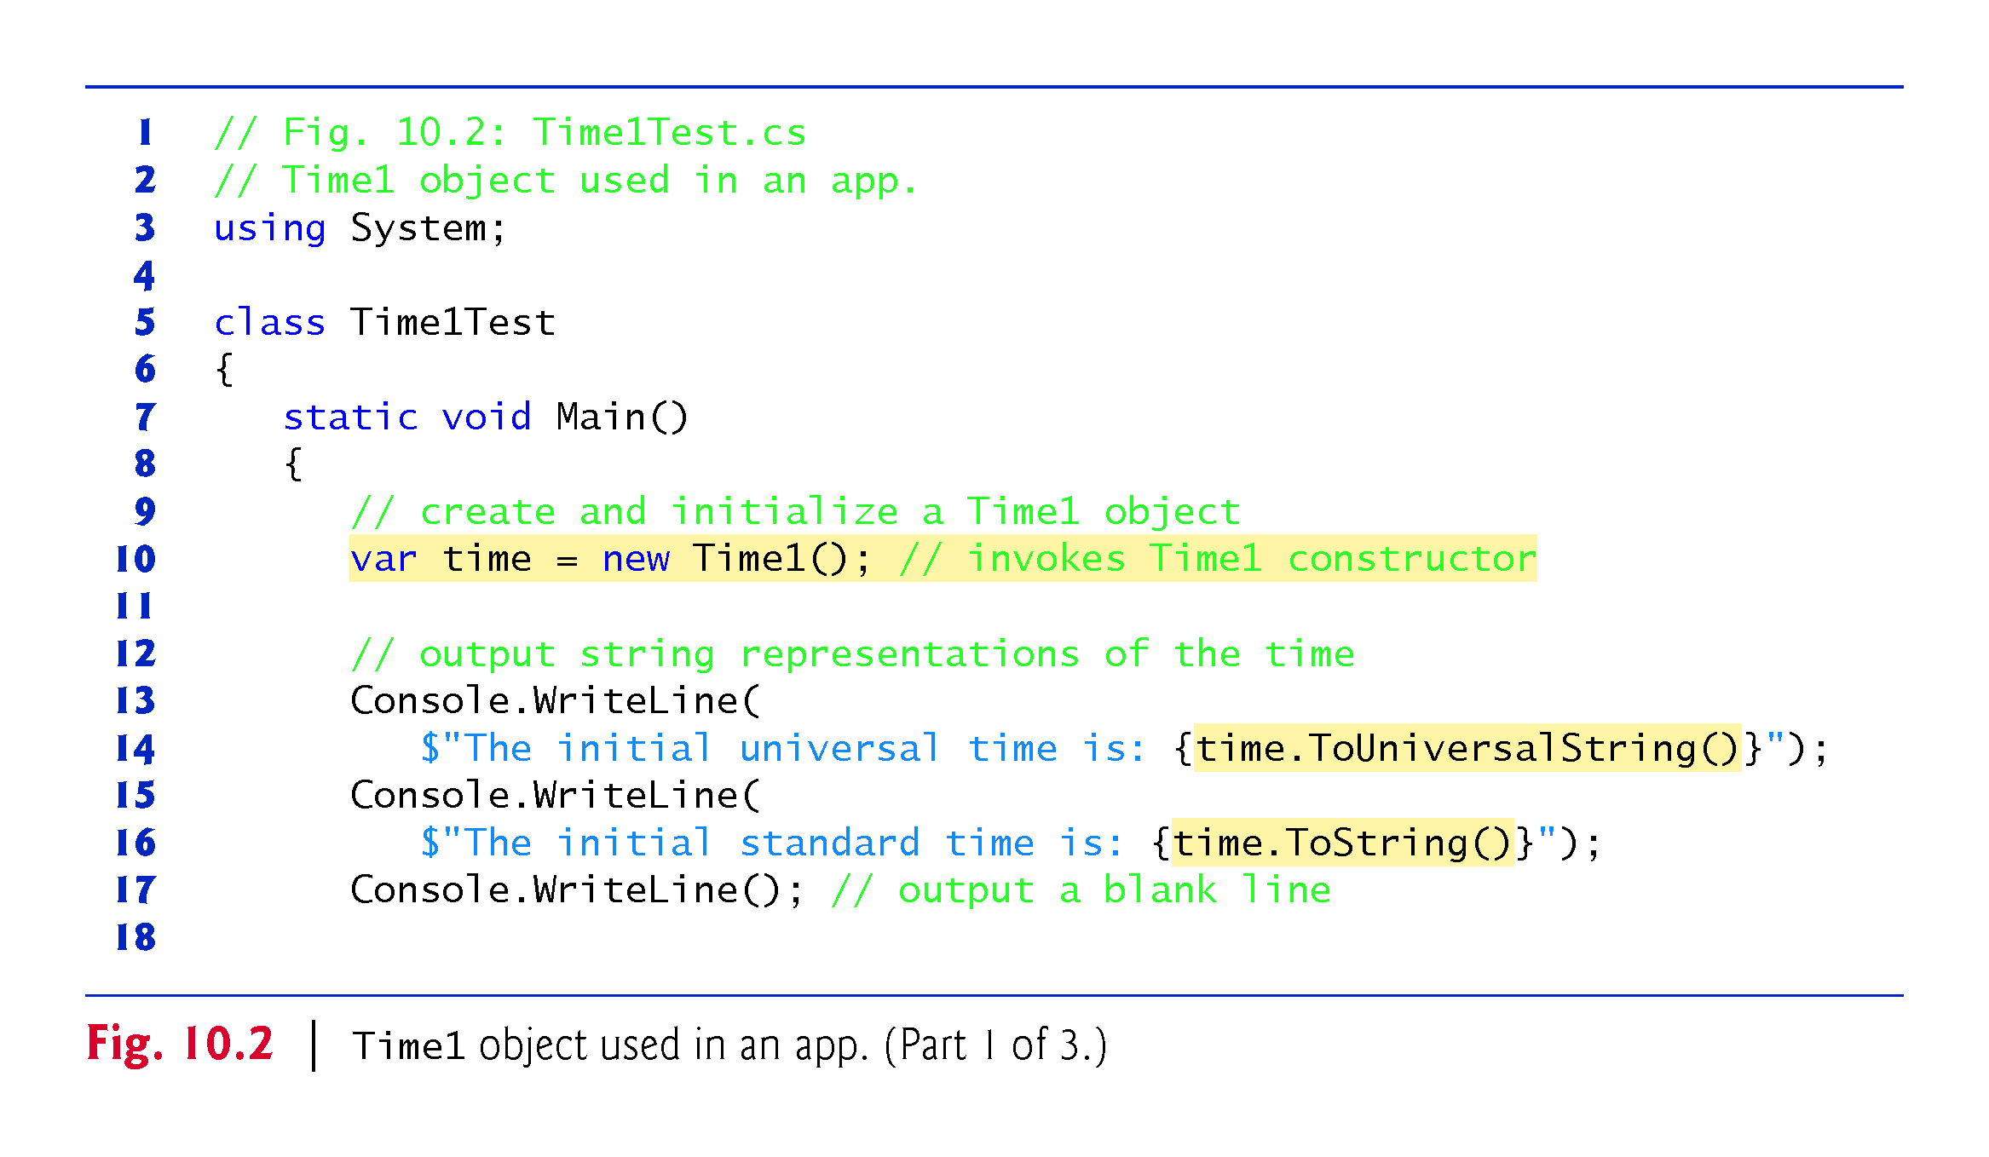

Slide 17
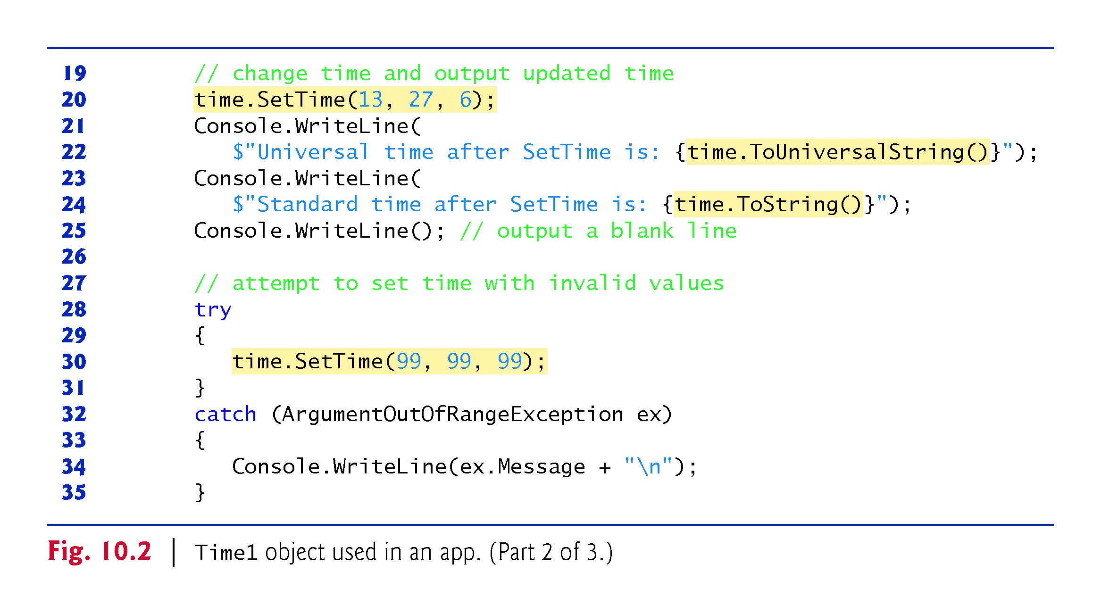

Slide 18
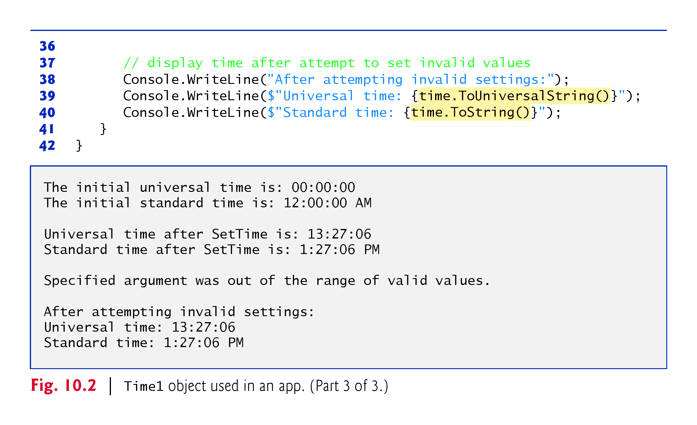

Slide 19
10.2 Time Class Case Study (Cont.)
Notes on the Time1 Class Declaration
Consider several class-design issues with respect to class Time1.
The time is represented as three integers for the hour, minute and second.
The actual data representation used within the class is of no concern to the class’s clients.
It would be perfectly reasonable for Time1 to represent the time internally as the number of seconds since midnight or the number of minutes and seconds since midnight.
Clients could use the same public methods and properties to get the same results without being aware of this
The Hour, Minute and Second properties would need to be reimplemented to work with the new data representation.

Slide 20
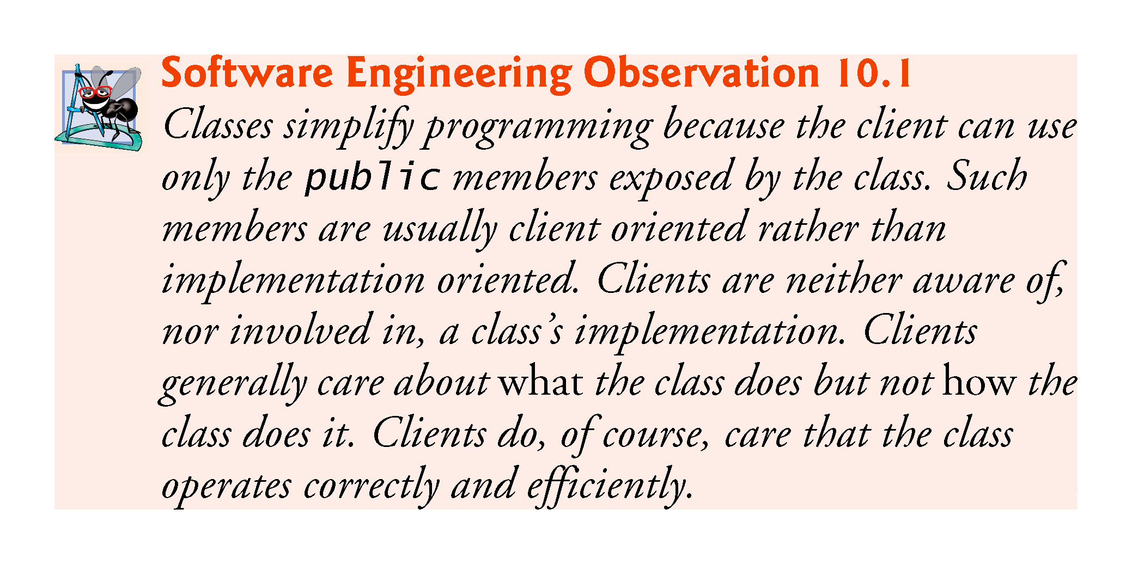

Slide 21
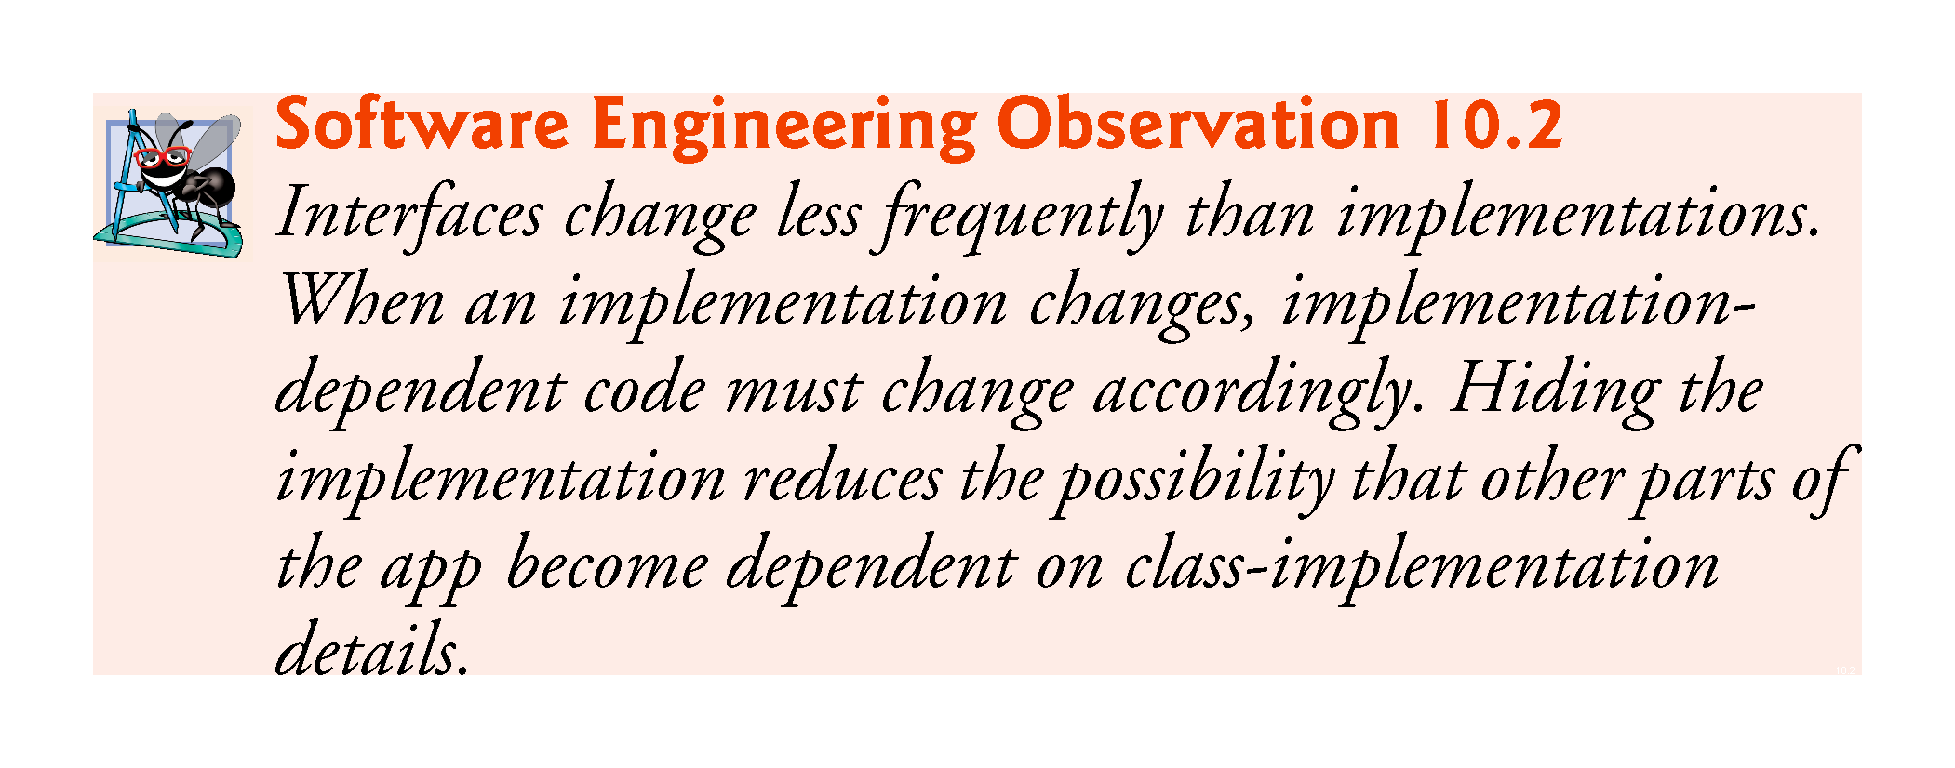

Slide 22
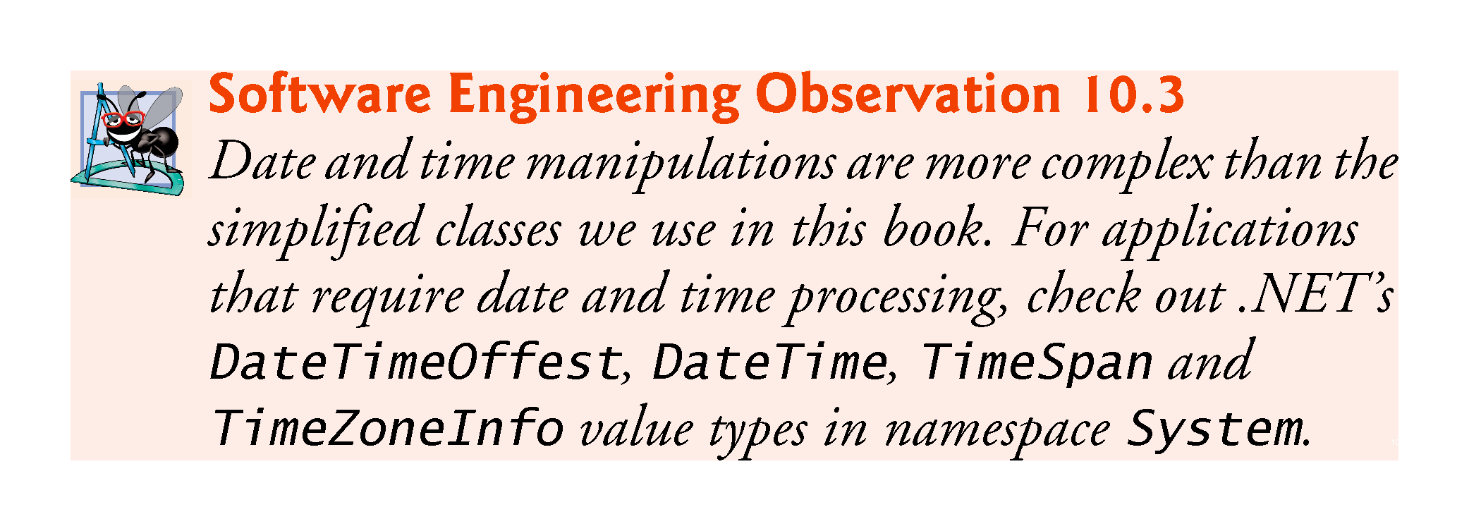

Slide 23
10.3 Controlling Access to Members
The access modifiers public and private control access to a class’s variables, methods and properties.
The primary purpose of public methods/properties is to present to the class’s clients a view of the services the class provides.
Clients of the class need not be concerned with how the class accomplishes its tasks.
A class’s private variables, properties and methods are not directly accessible to the class’s clients.

Slide 24
10.3 Controlling Access to Members
Figure 10.3 demonstrates that private class members are not directly accessible outside the class.
In this app, we use a modified version of class Time1 that declares private instance variables hour, minute and second, rather than public properties Hour, Minute and Second.
Members of a class—for instance, properties, methods and instance variables—have private access by default.

Slide 25
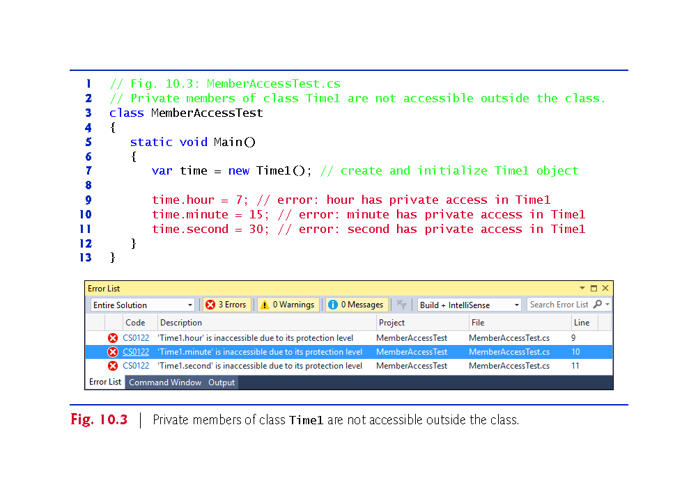

Slide 26
10.4 Referring to the Current Object’s Members with the this Reference
Every object can access a reference to itself with keyword this.
When a non-static method/property is called, its body implicitly uses keyword this to refer to the object’s instance variables and other non-static class members.
As you’ll see in Fig. 10.4, you can also use keyword this explicitly in a non-static method’s body.

Slide 27
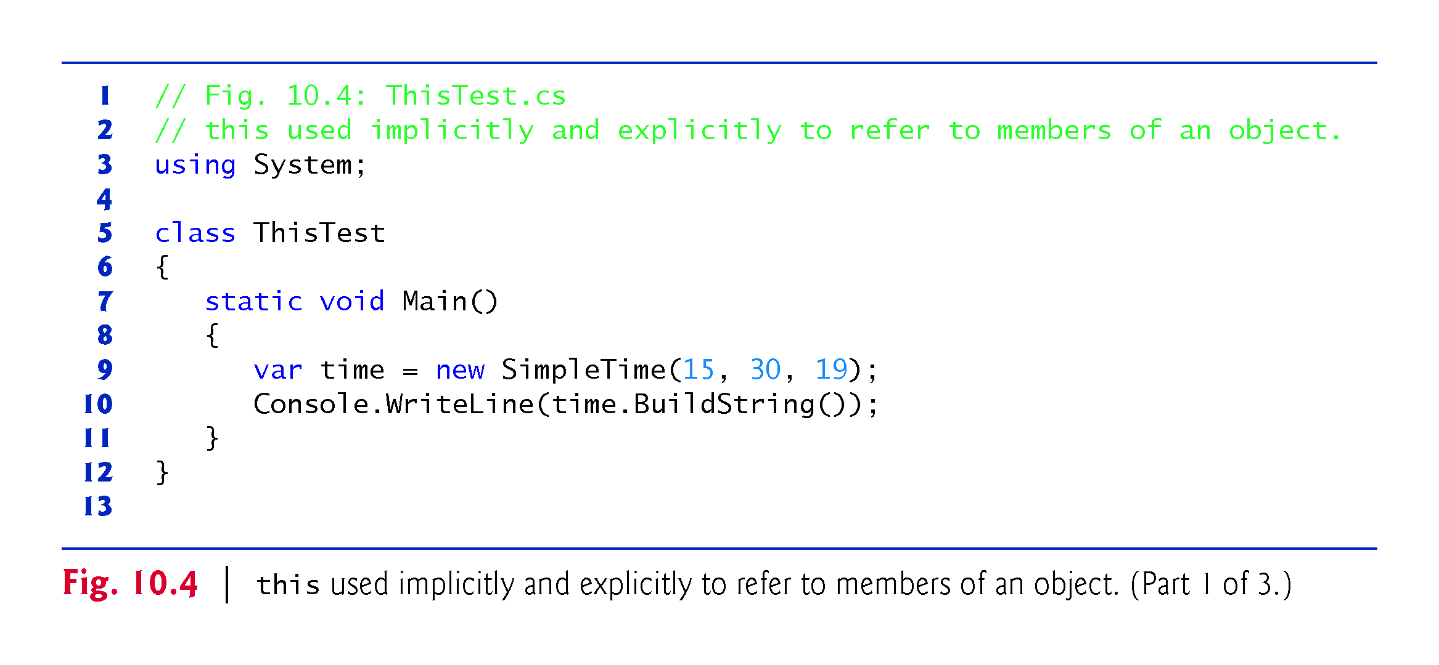

Slide 28
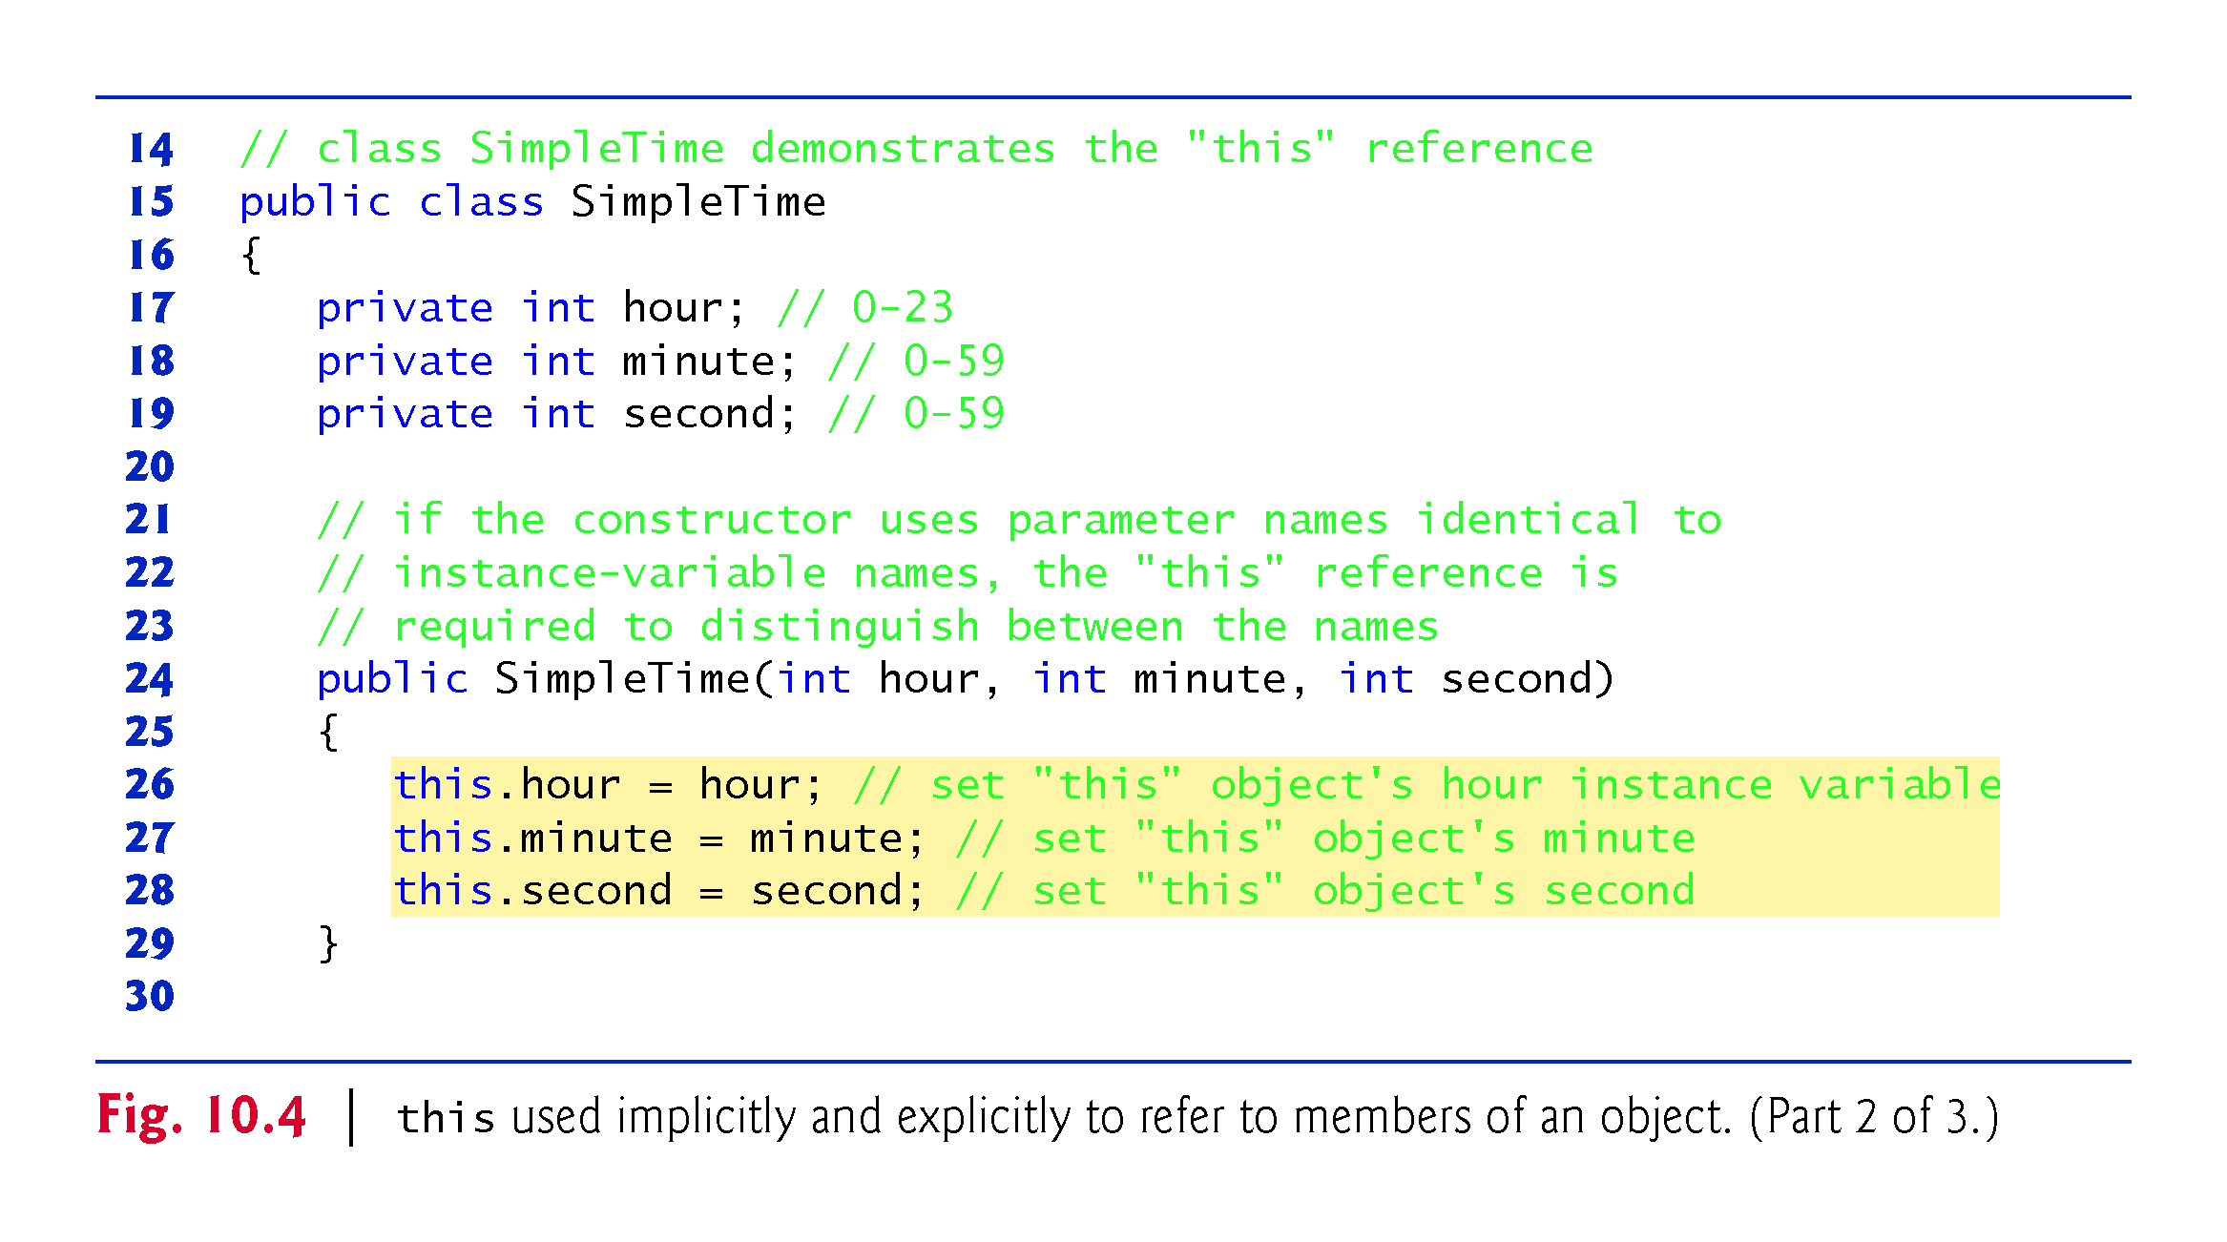

Slide 29
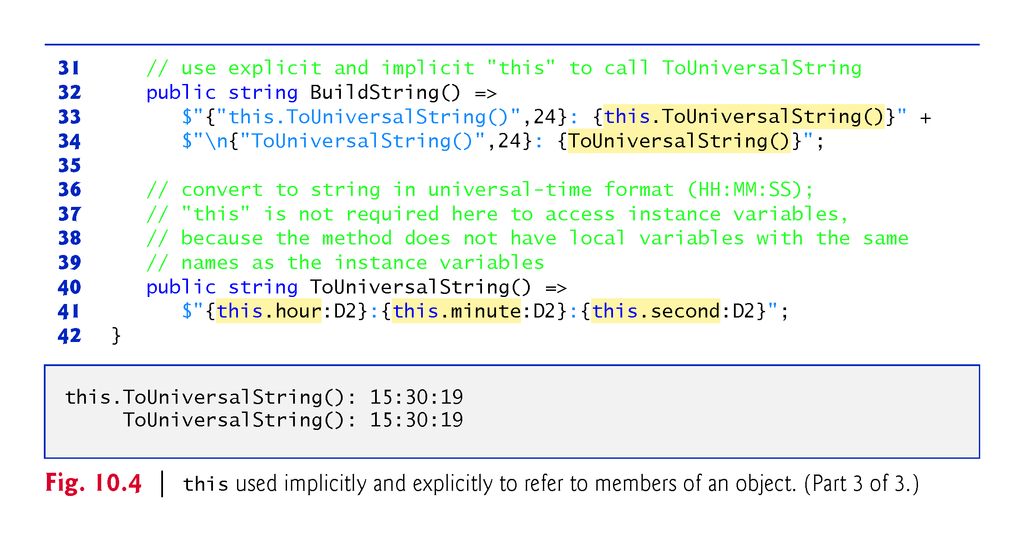

Slide 30
10.4 Referring to the Current Object’s Members with the this Reference (Cont.)
If the constructor’s parameter names are identical to the class’s instance-variable names, so they hide (shadow) the corresponding instance variables.
You can use the this reference to refer to hidden instance variables explicitly.
If a member is not hidden, the this keyword is implied, but can be included explicitly.

Slide 31
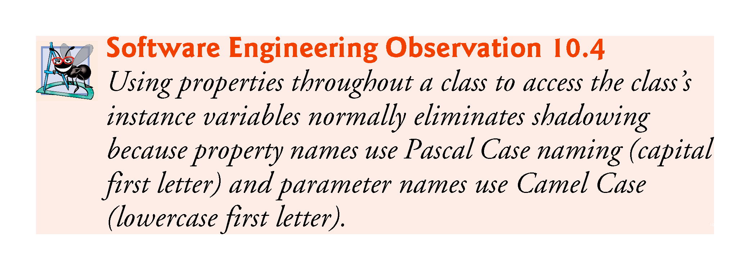

Slide 32
10.5 Time Class Case Study: Overloaded Constructors
Overloaded constructors enable objects of a class to be conveniently initialized in different ways.
To overload constructors, simply provide multiple constructor declarations with different signatures.

Slide 33
10.5.1 Class Time2 with Overloaded Constructors
Class Time2 (Fig. 10.5) contains overloaded constructors.

Slide 34
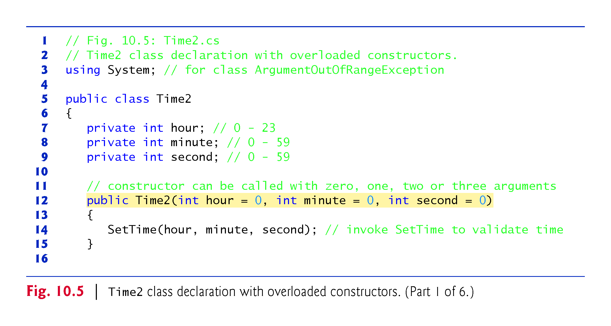

Slide 35
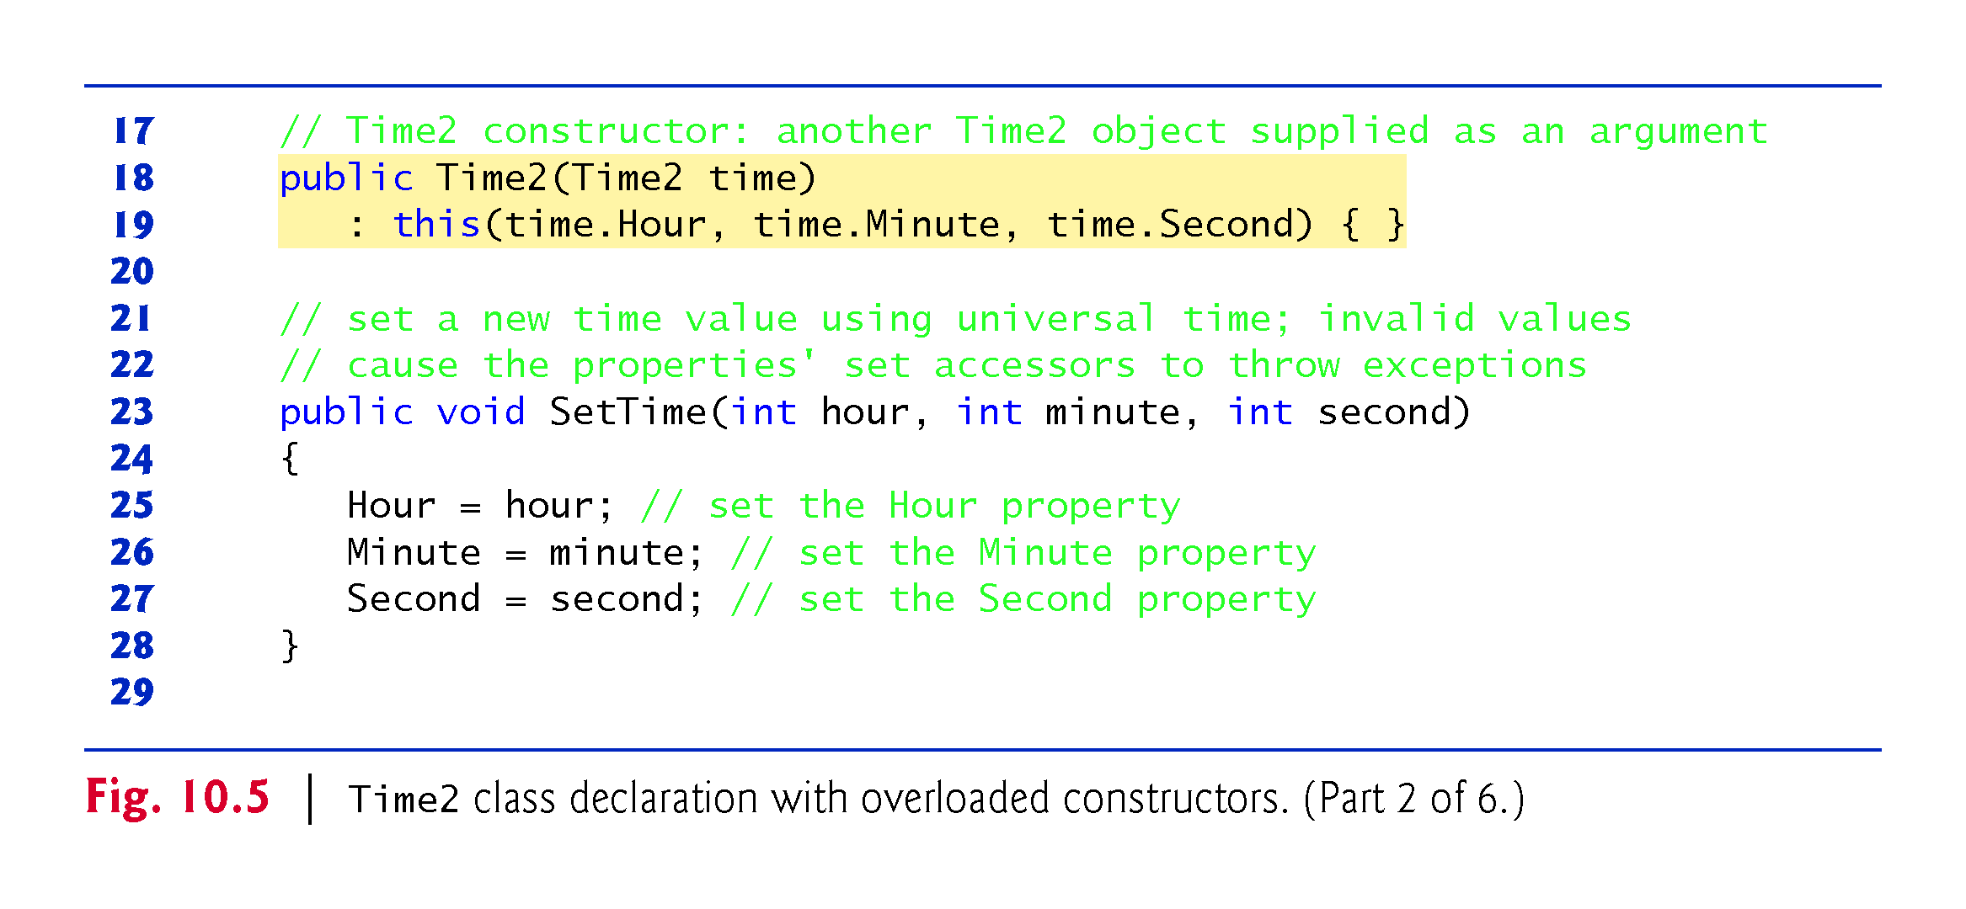

Slide 36
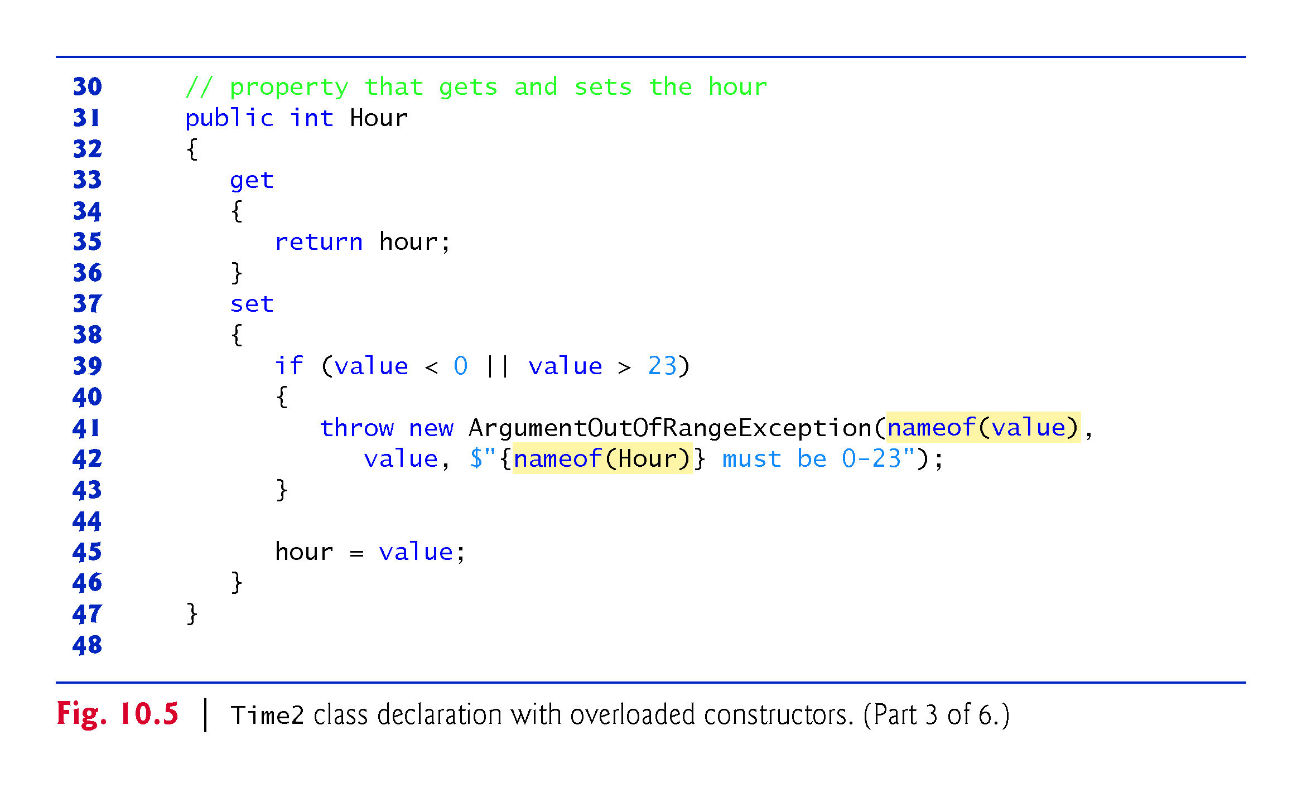

Slide 37
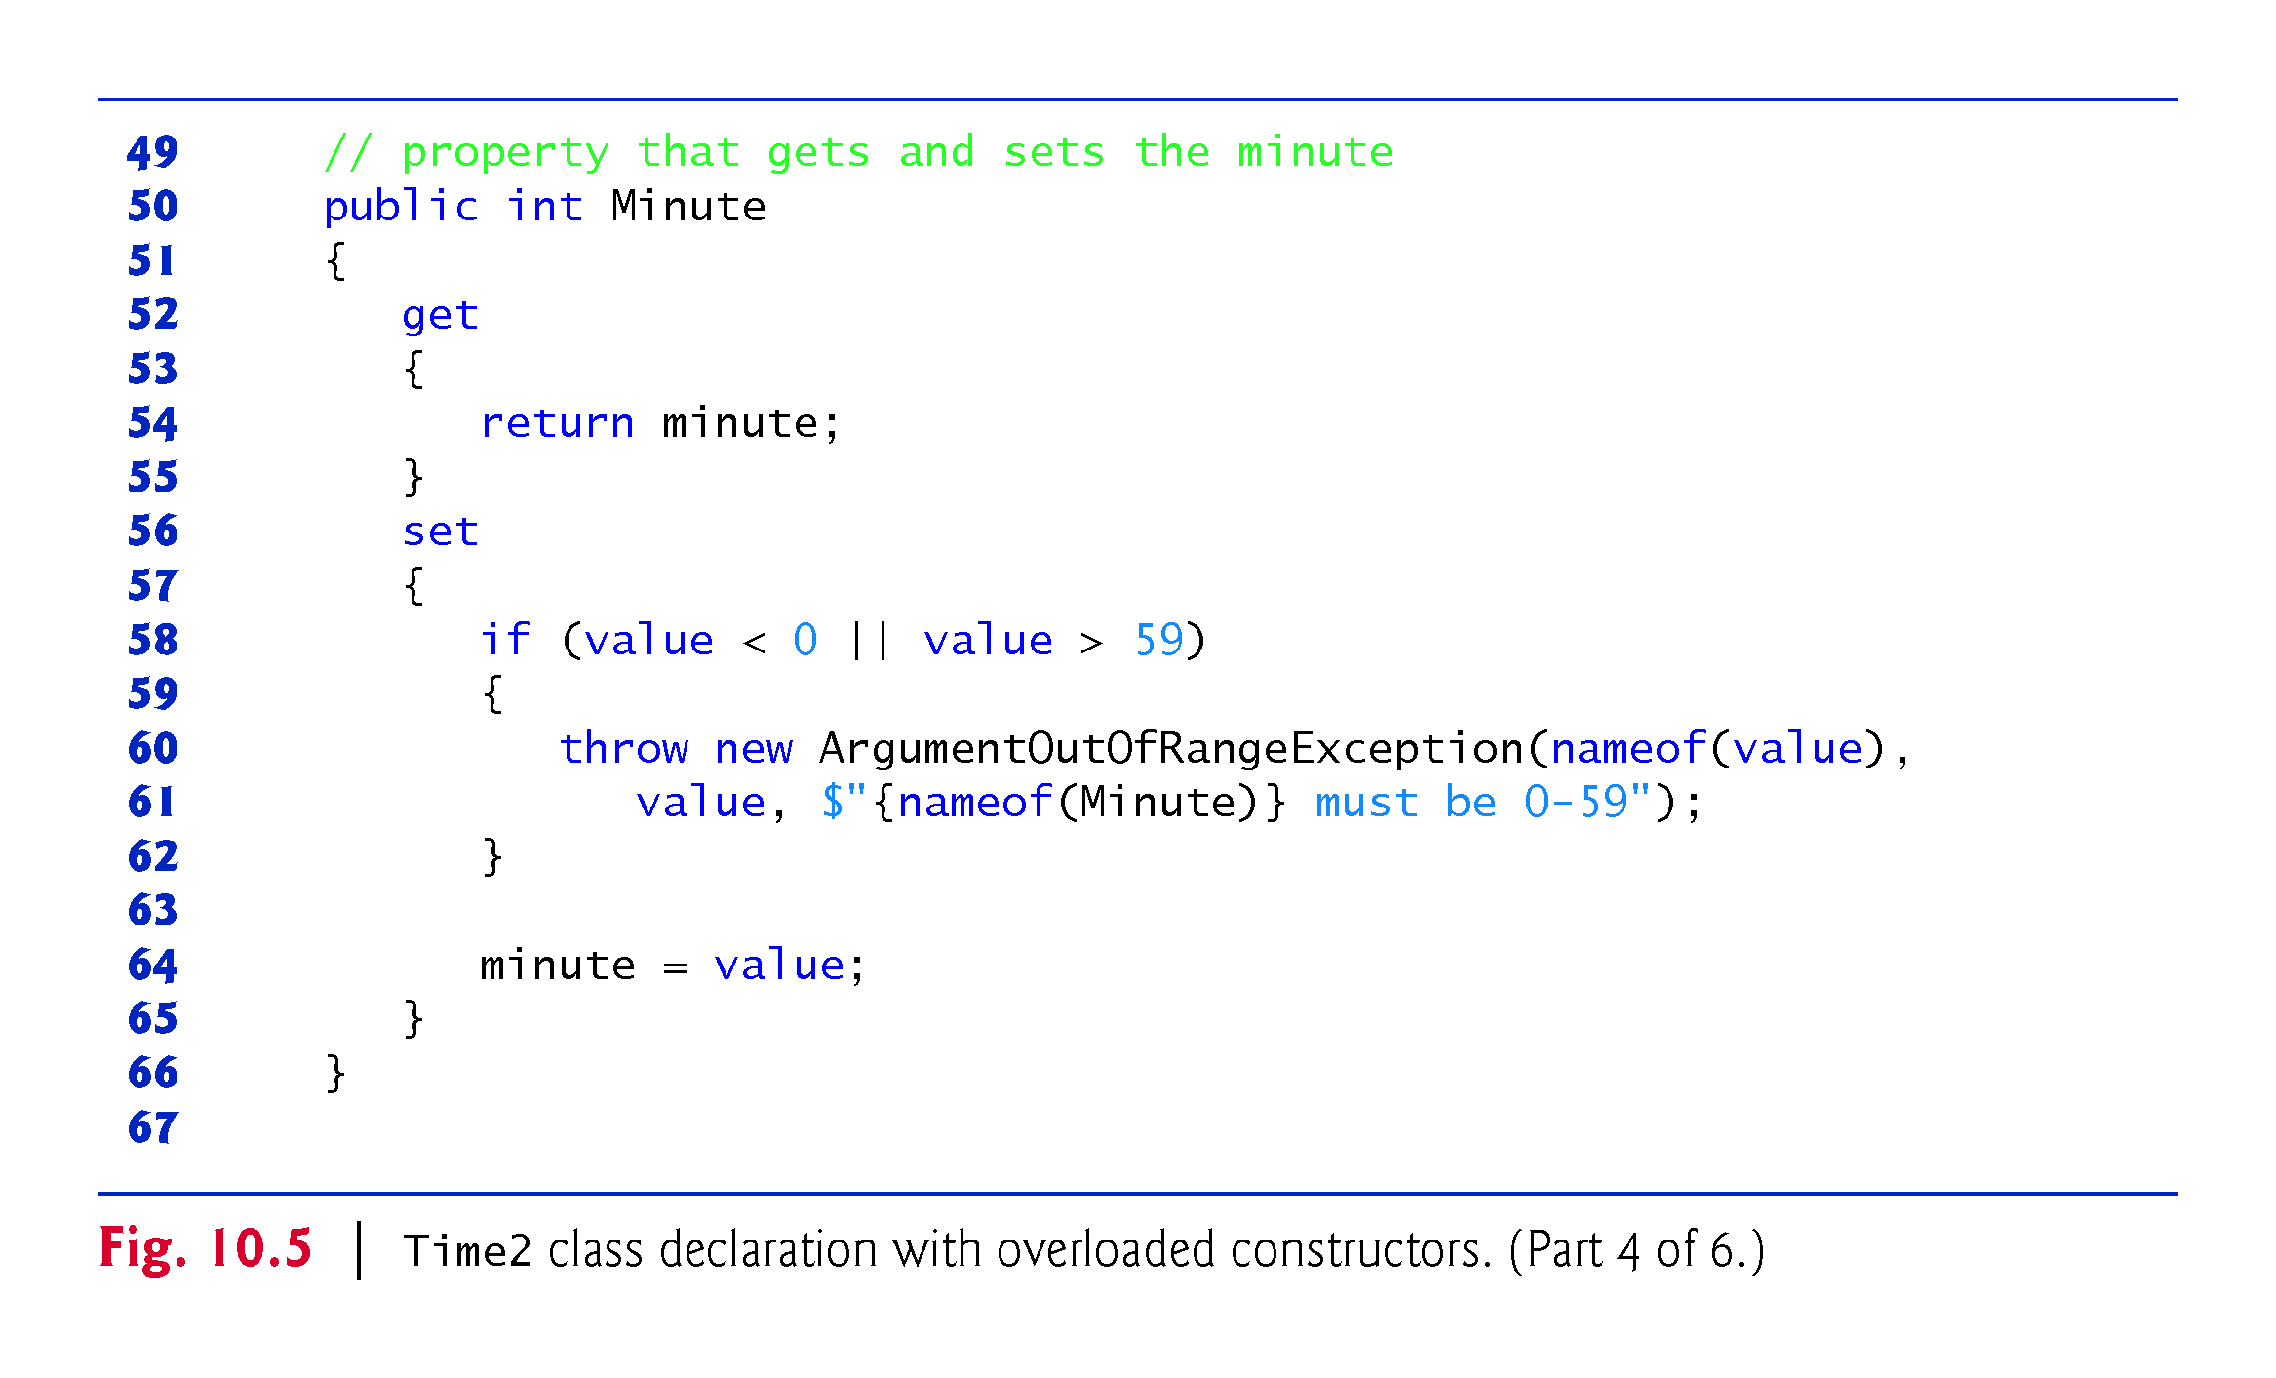

Slide 38
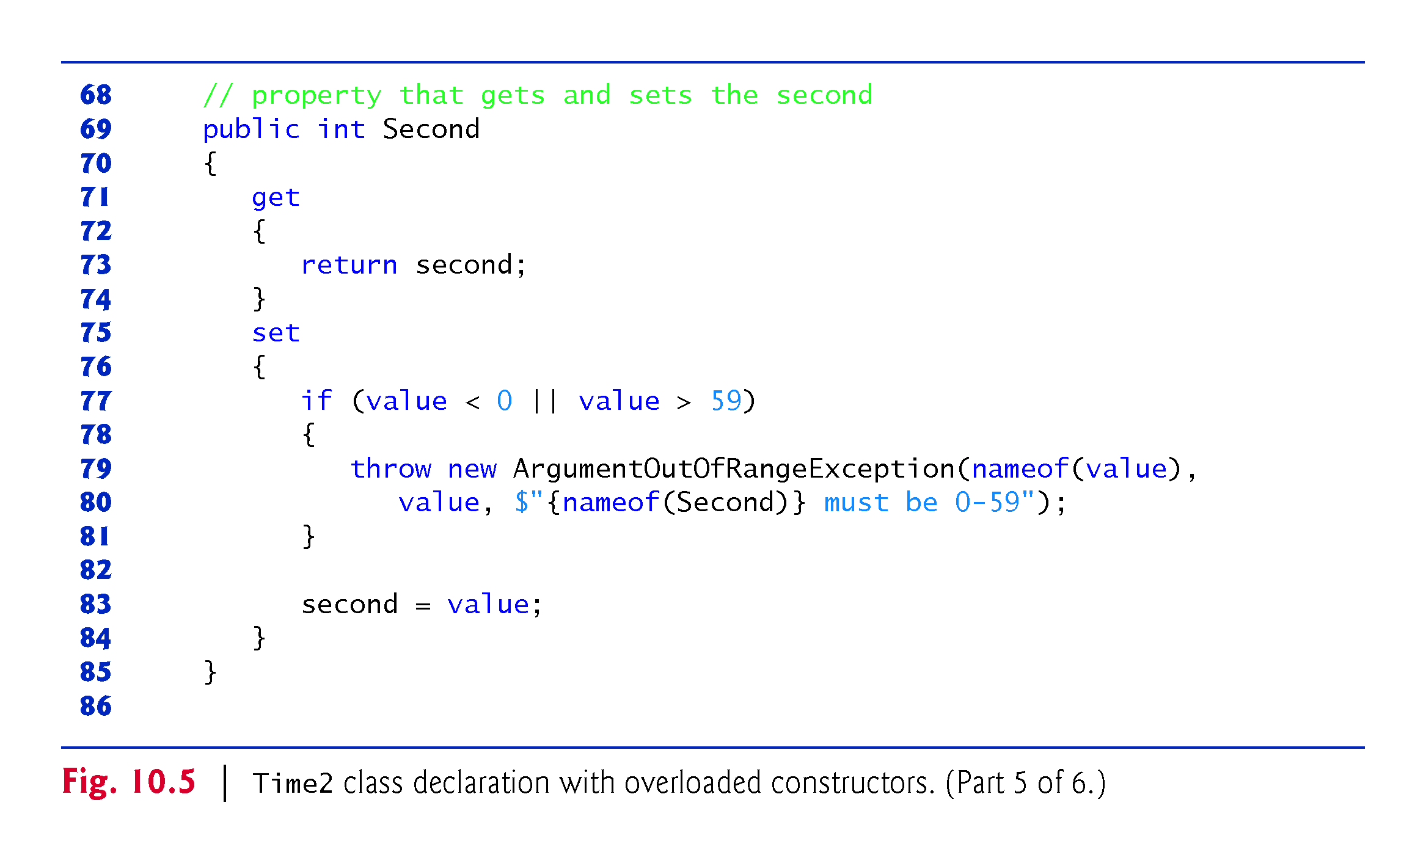

Slide 39
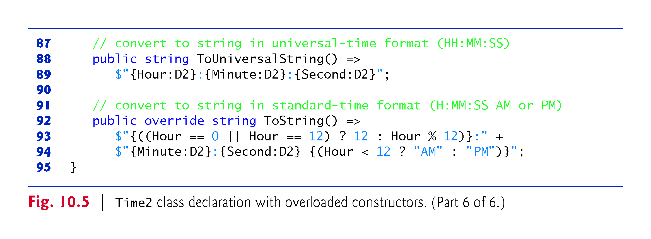

Slide 40
10.5 Time Class Case Study: Overloaded Constructors (Cont.)
Class Time2’s Three-Argument Constructor
Lines 12–15 declare a constructor with three default parameters.
This is also the class’s parameterless constructor because you can call the constructor without arguments and the compiler will automatically provide the default parameter values.

Slide 41
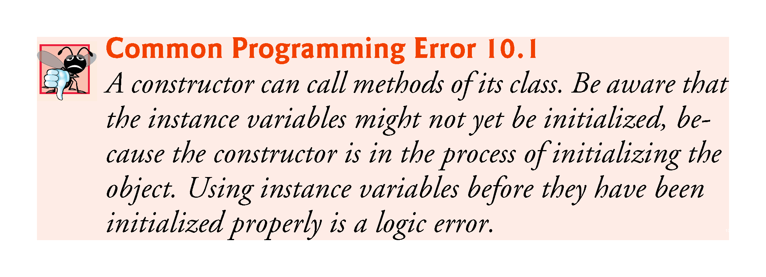

Slide 42
10.5 Time Class Case Study: Overloaded Constructors (Cont.)
Using this as in line 19
: this(time.Hour, time.Minute, time.Second) { }
is called a constructor initializer.
Enables a class to reuse initialization code provided by a constructor, rather than defining similar code in another constructor.

Slide 43
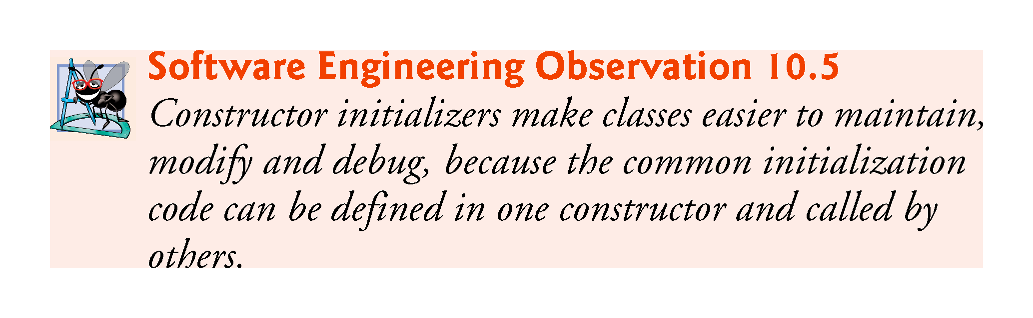

Slide 44
10.5 Time Class Case Study: Overloaded Constructors (Cont.)
Notes Regarding Class Time2’s Methods, Properties and Constructors
Consider changing the representation of the time to a single int value representing the total number of seconds that have elapsed since midnight.
Only the bodies of the methods that access the private data directly would need to change.
There would be no need to modify the bodies of methods SetTime, ToUniversalString or ToString.
When there is no access modifier before a get or set accessor, the accessor inherits the access modifier preceding the property name.

Slide 45
10.5 Time Class Case Study: Overloaded Constructors (Cont.)
It’s common to include in an exception’s error message a variable’s or property’s identifier.
Can help a client-code programmer understand the context in which the exception occurred.
Prior to C# 6, you had to hard code these identifiers into your error-messages.
As of C# 6, you can instead use the nameof operator, which returns a string representation of the identifier enclosed in parentheses.

Slide 46
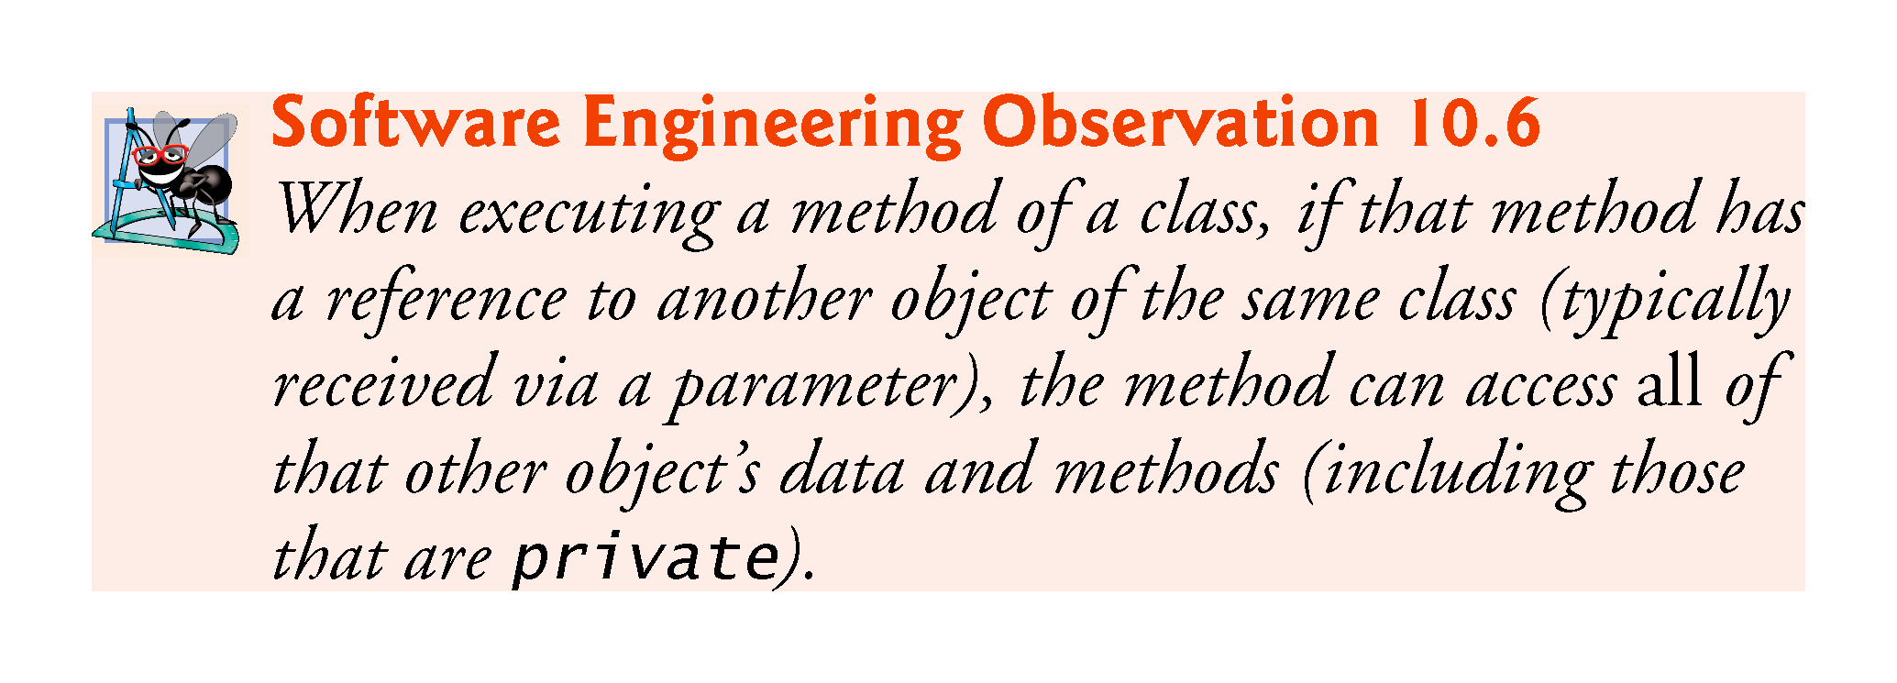

Slide 47
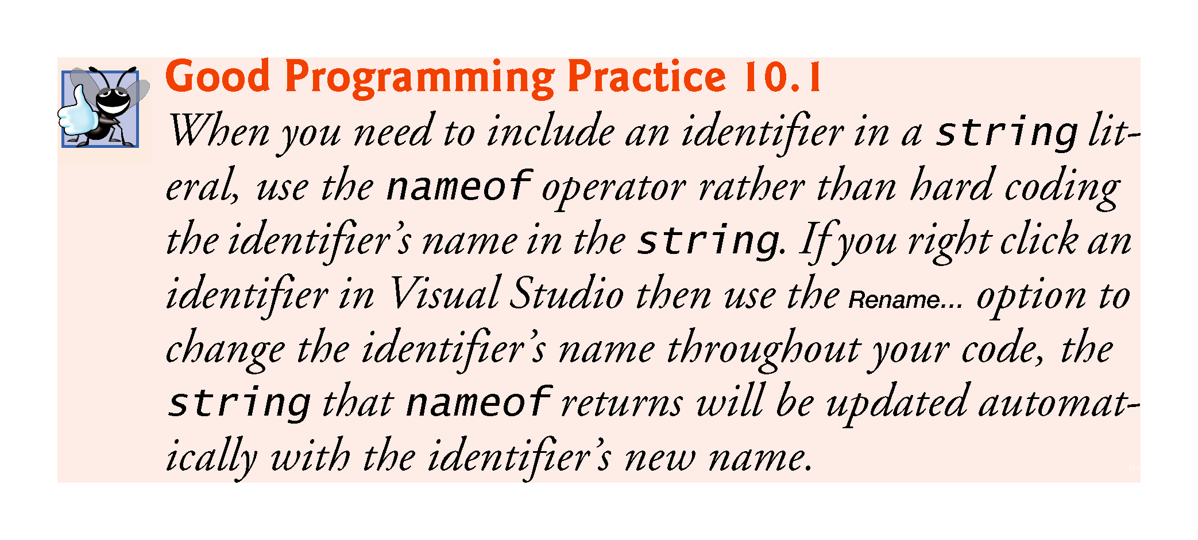

Slide 48
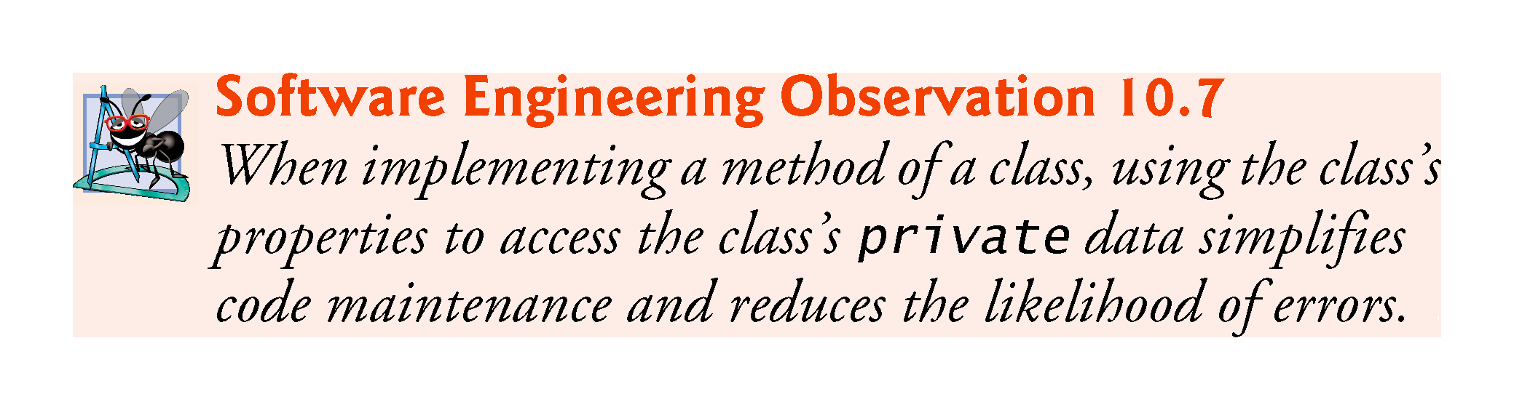

Slide 49
10.6 Time Class Case Study: Overloaded Constructors (Cont.)
Class Time2Test (Fig. 10.6) creates six Time2 objects to invoke the overloaded Time2 constructors.

Slide 50
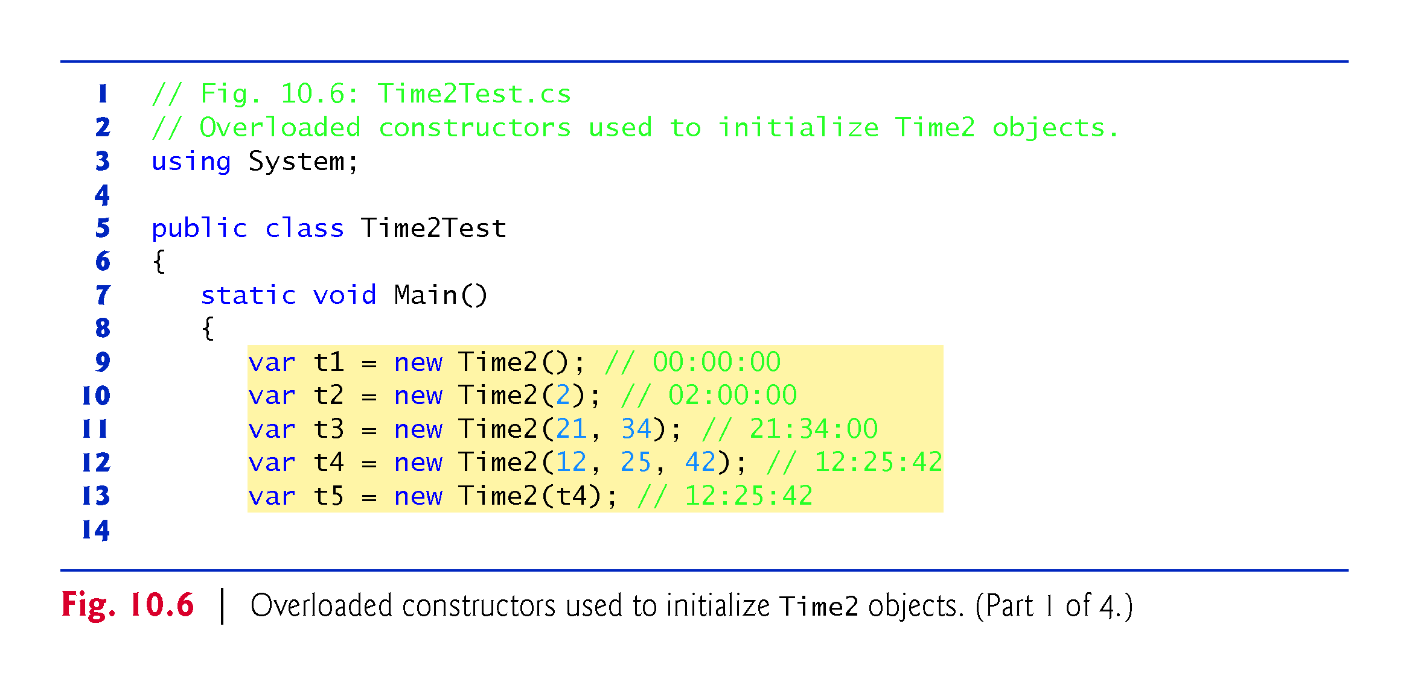

Slide 51
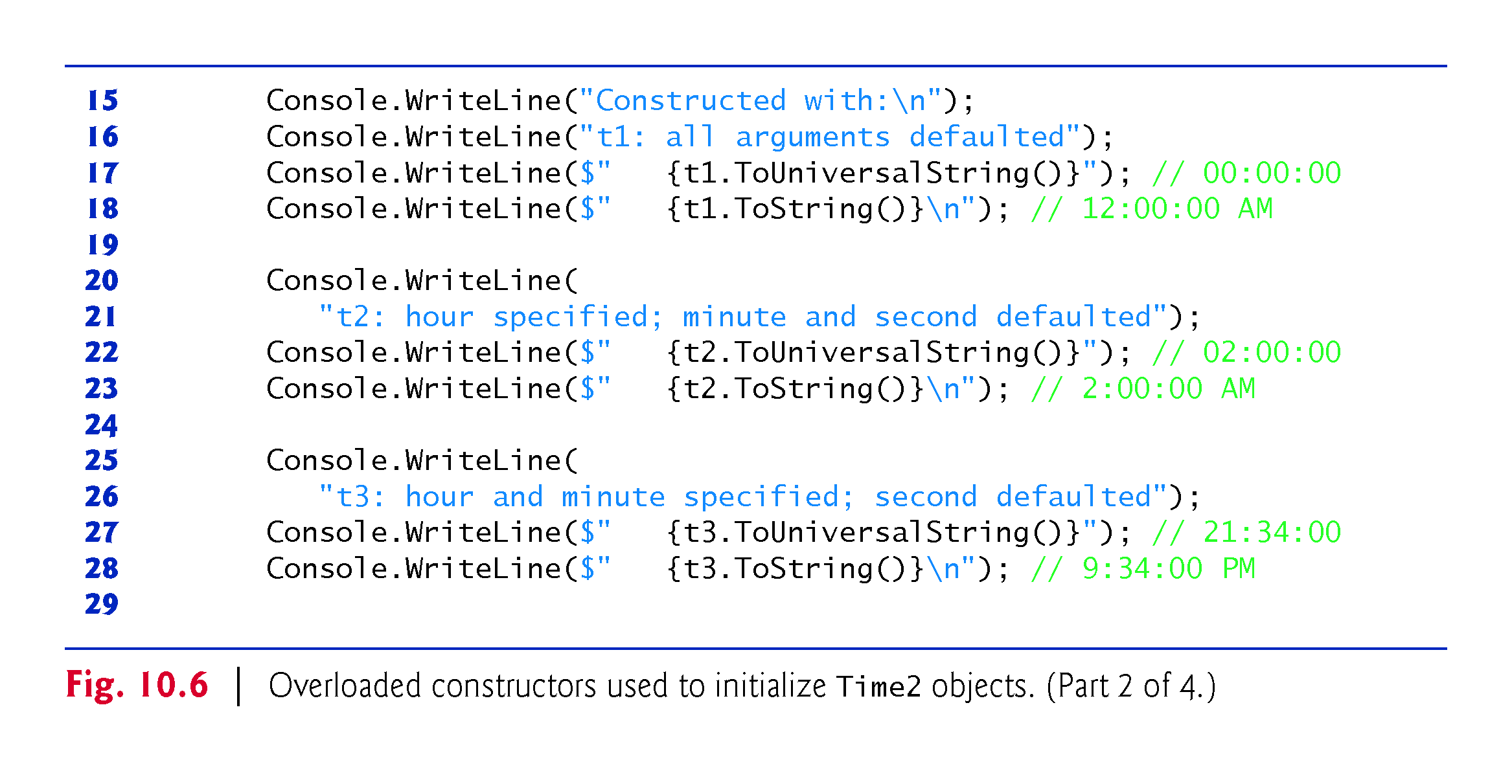

Slide 52
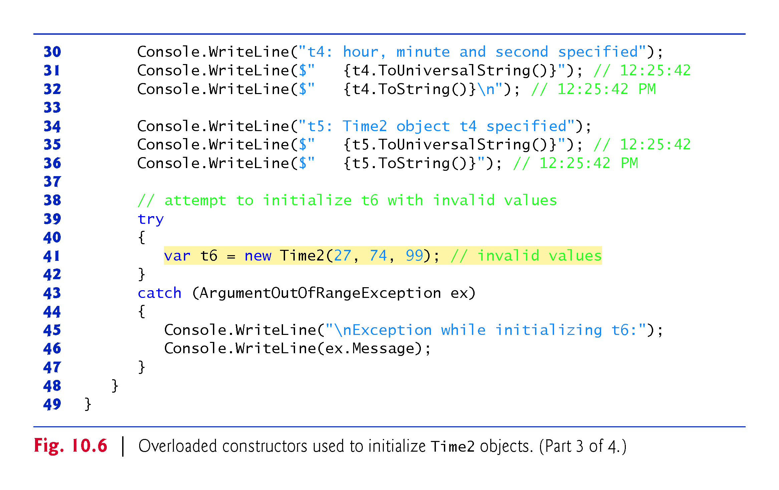

Slide 53
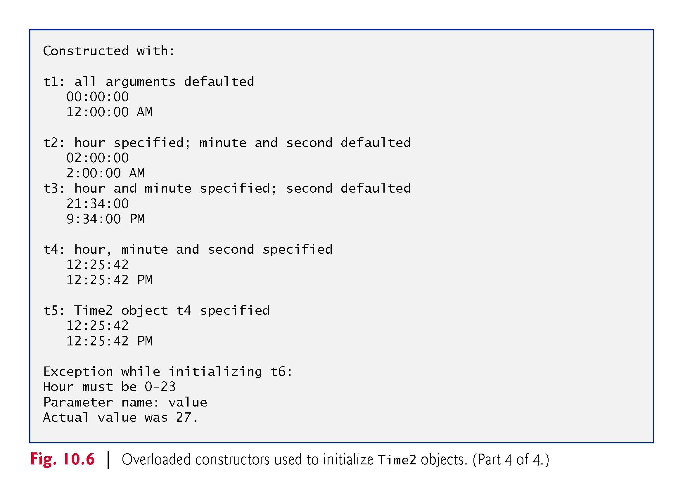

Slide 54
10.6 Default and Parameterless Constructors
Every class must have at least one constructor.
If you do not provide any constructors in a class’s declaration, the compiler creates a default constructor that takes no arguments when it is invoked.
The compiler will not create a default constructor for a class that explicitly declares at least one constructor.
If you have declared a constructor, but want to be able to invoke the constructor with no arguments, you must declare a parameterless constructor.

Slide 55
10.7 Composition
A class can have objects of values types or references to objects of other classes as members.
This is called composition and is sometimes referred to as a has-a relationship.

Slide 56
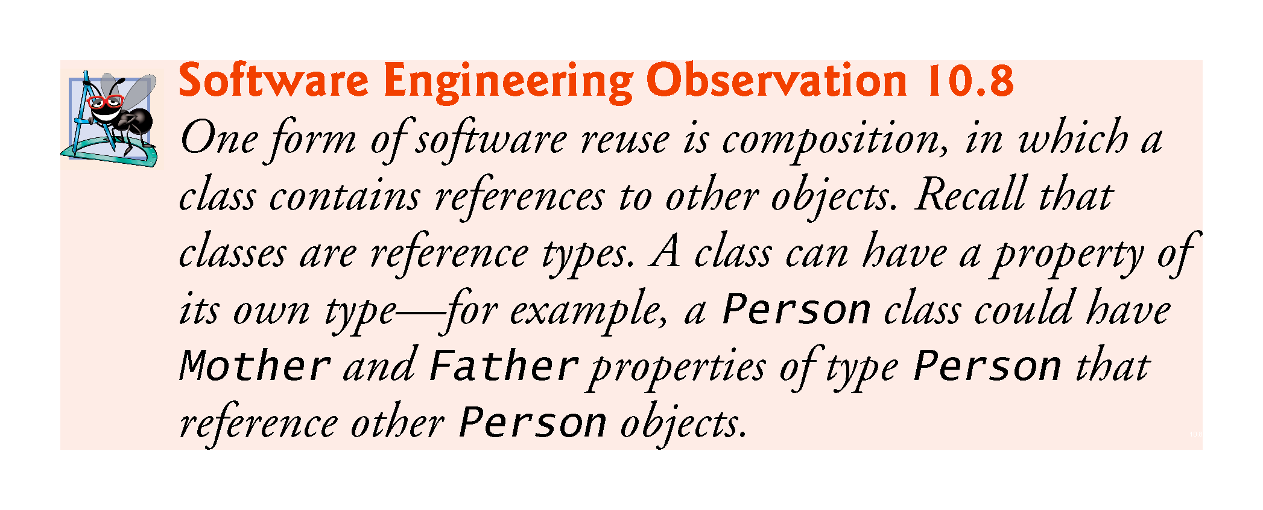

Slide 57
10.7.1 Class Date
Class Date (Fig. 10.7) declares instance variables month and day, and auto-implemented property Year (line 9) to represent a date.

Slide 58
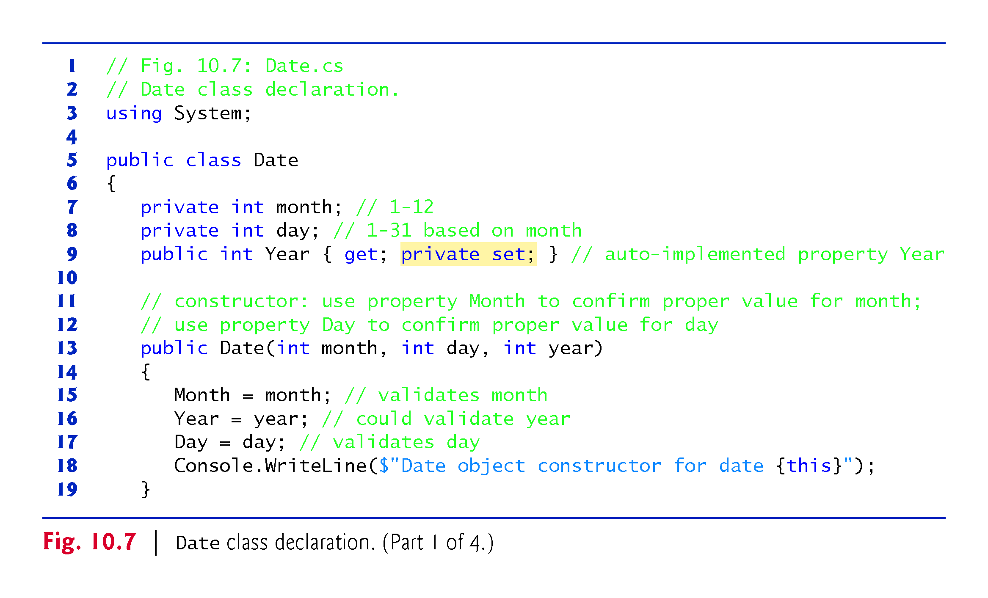

Slide 59
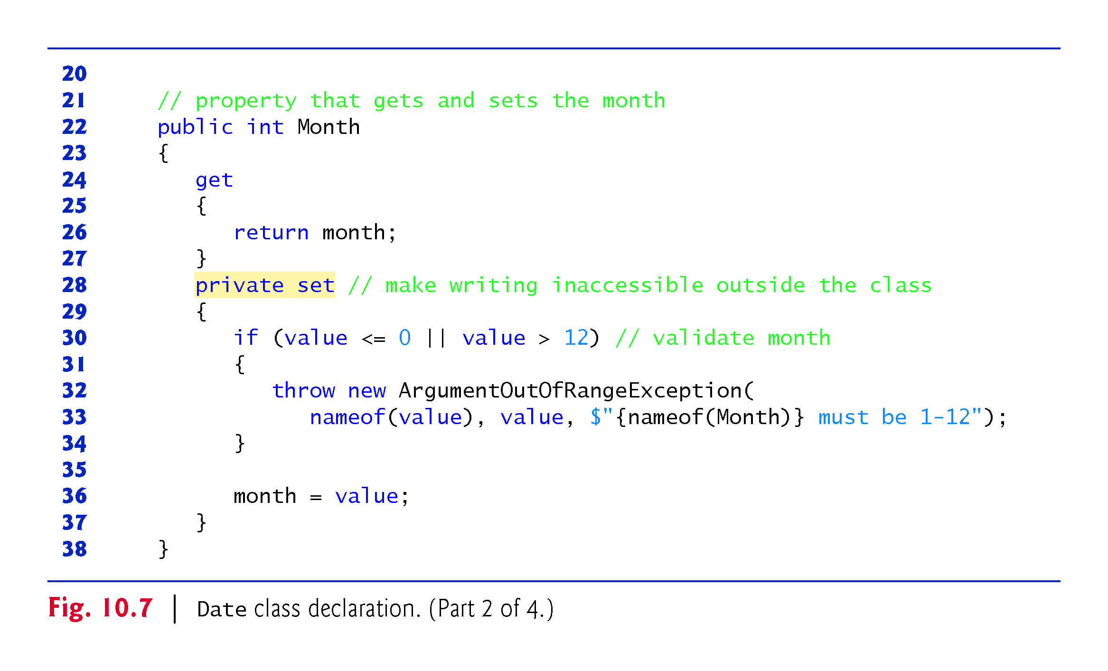

Slide 60
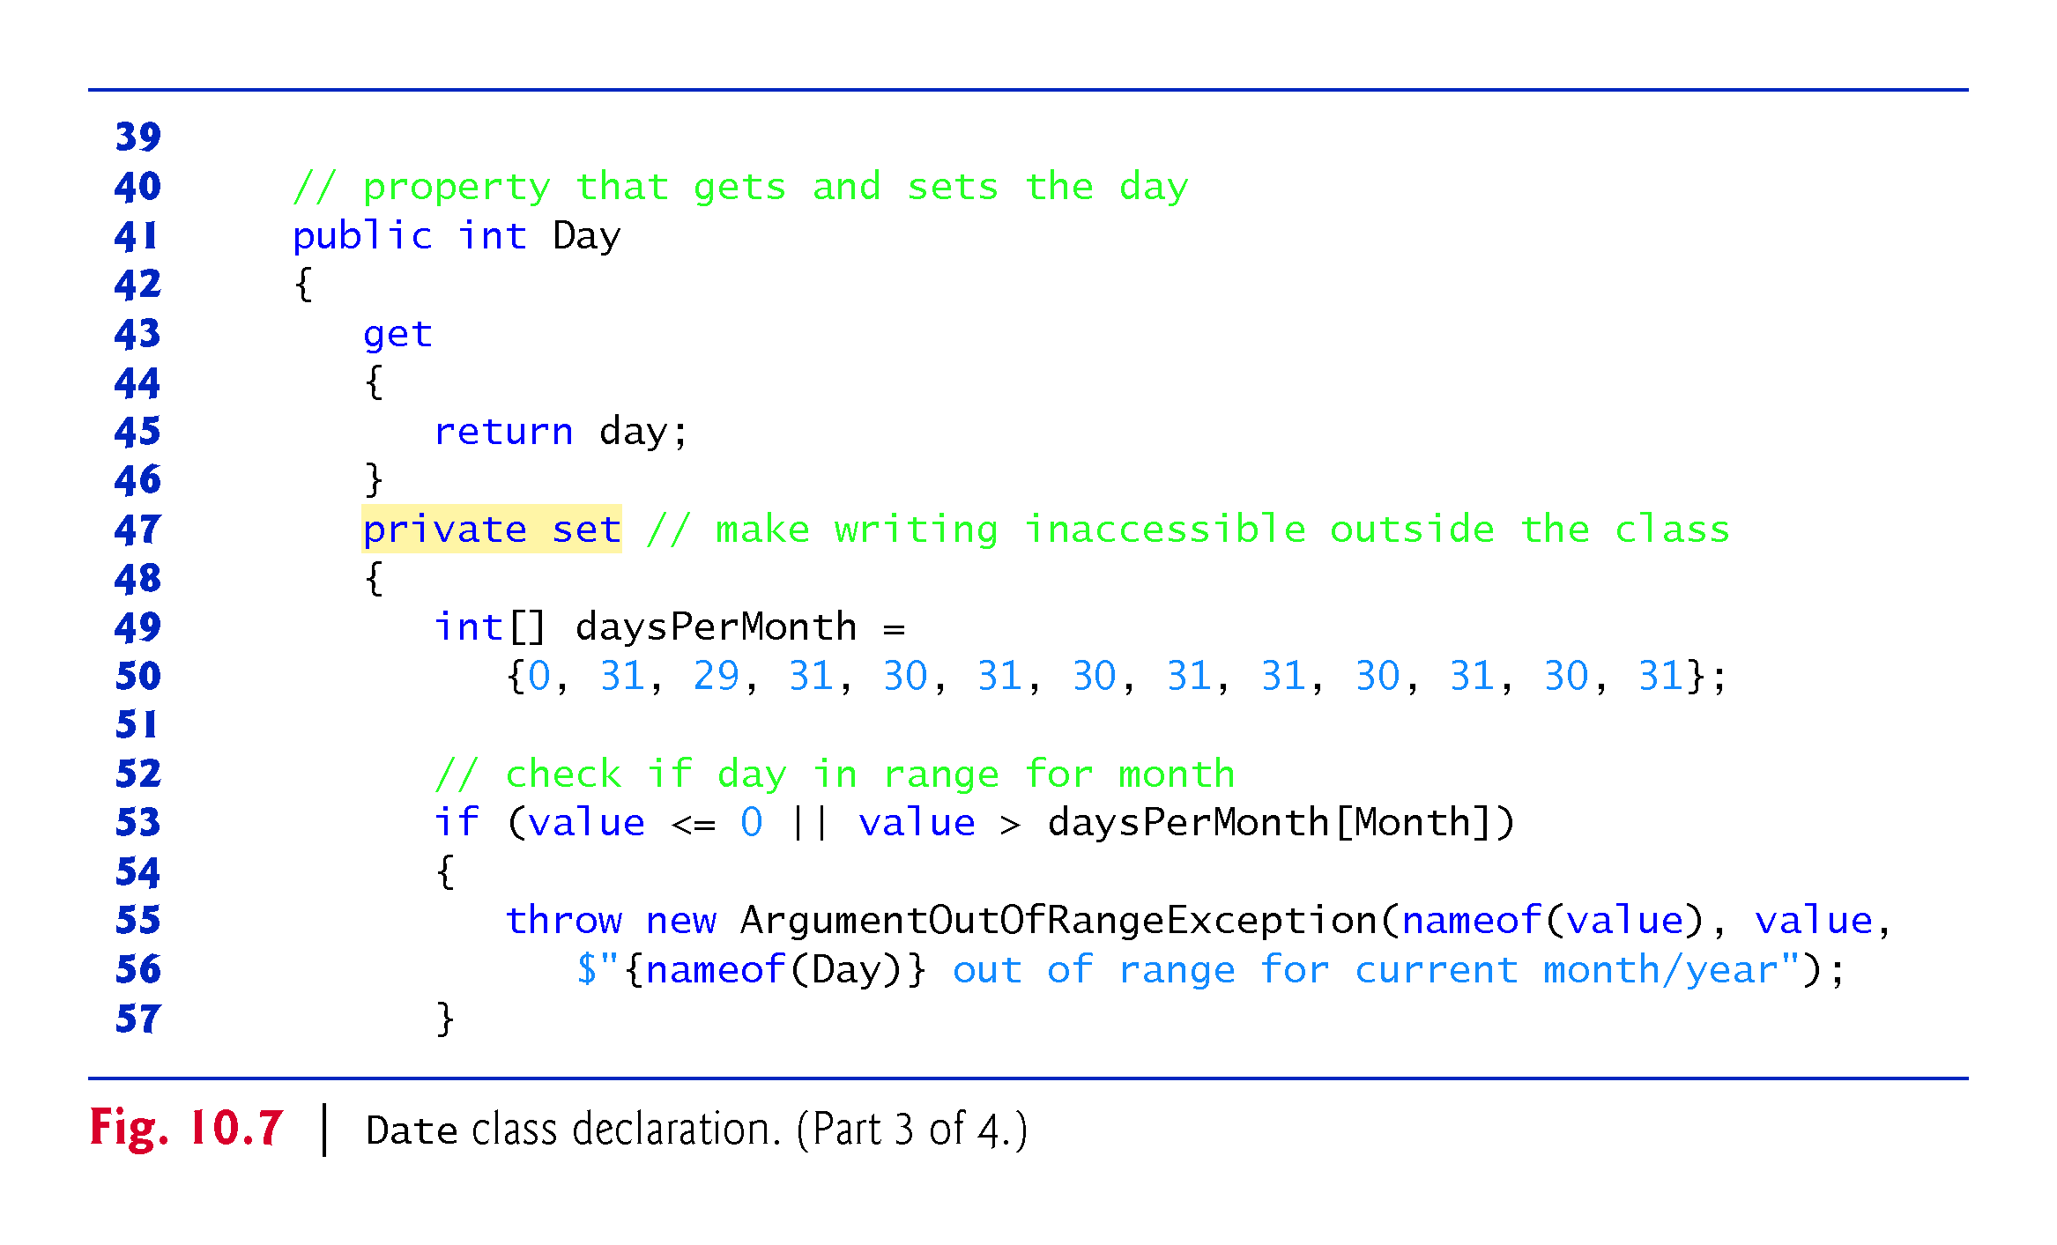

Slide 61
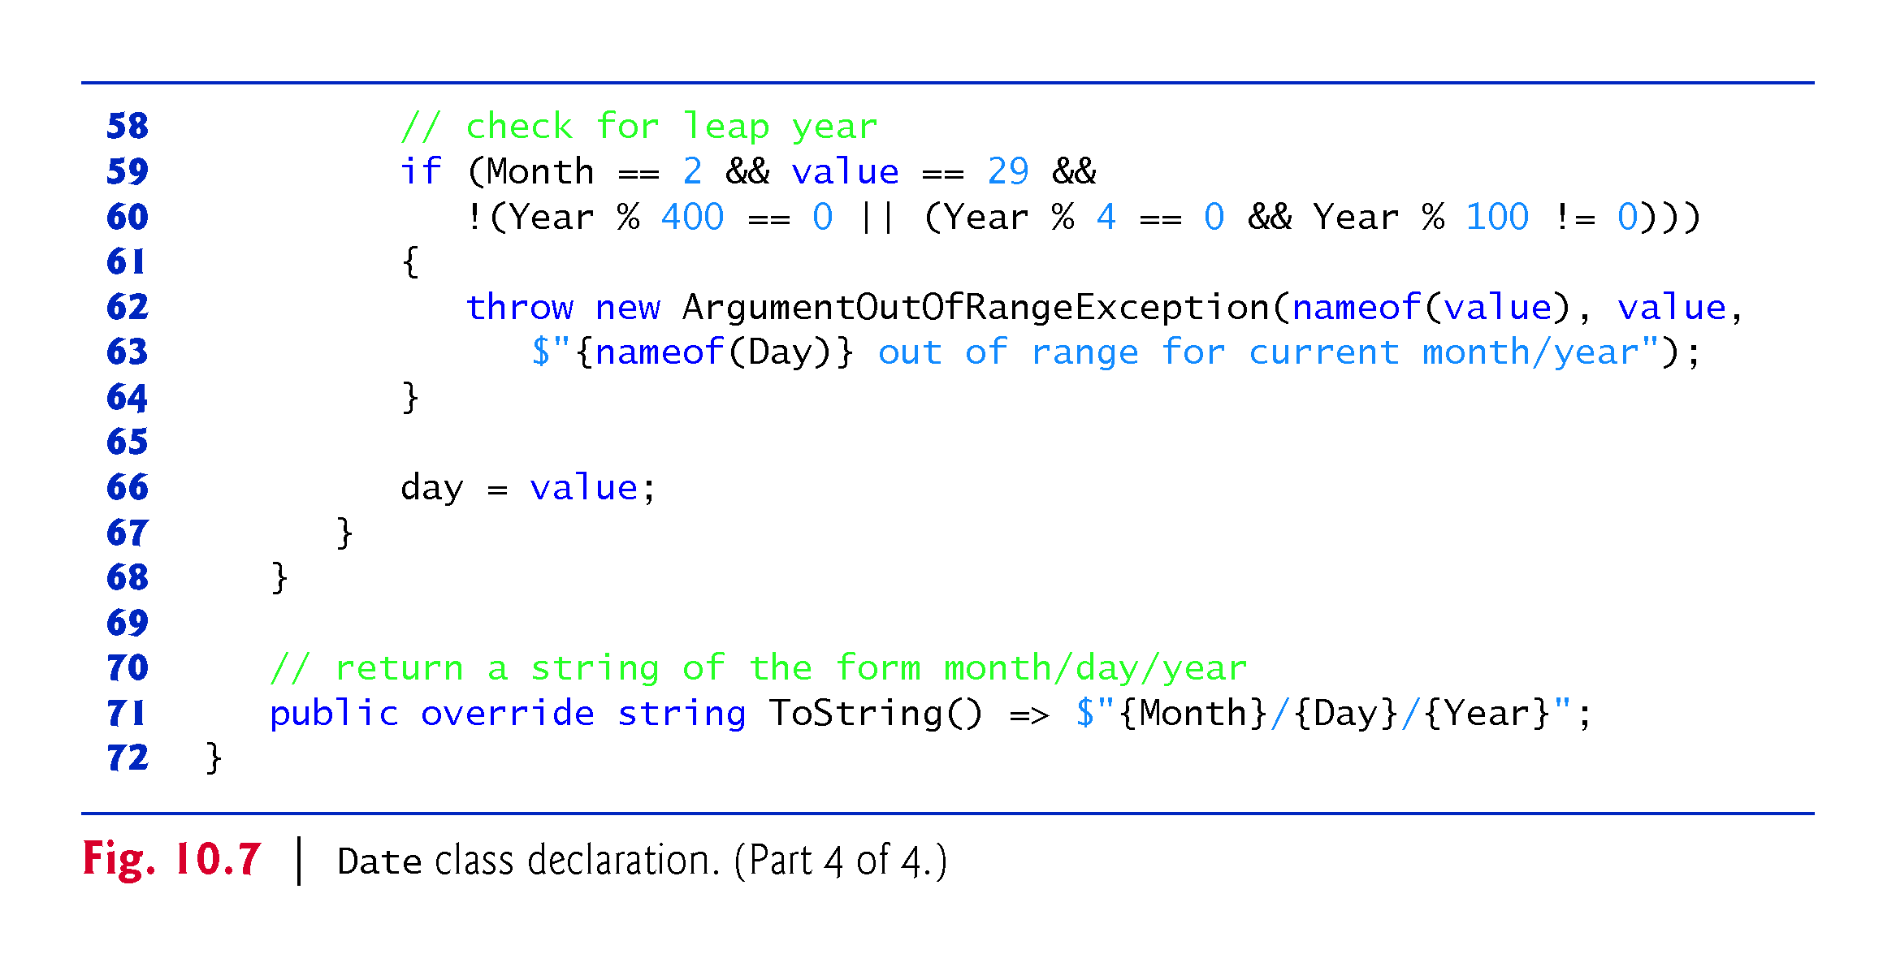

Slide 62
10.7.2 Class Employee
Class Employee (Fig. 10.8) has public auto-implemented, getter-only properties FirstName, LastName, BirthDate and HireDate
Demonstrates that a class can have references to objects of other classes as members

Slide 63
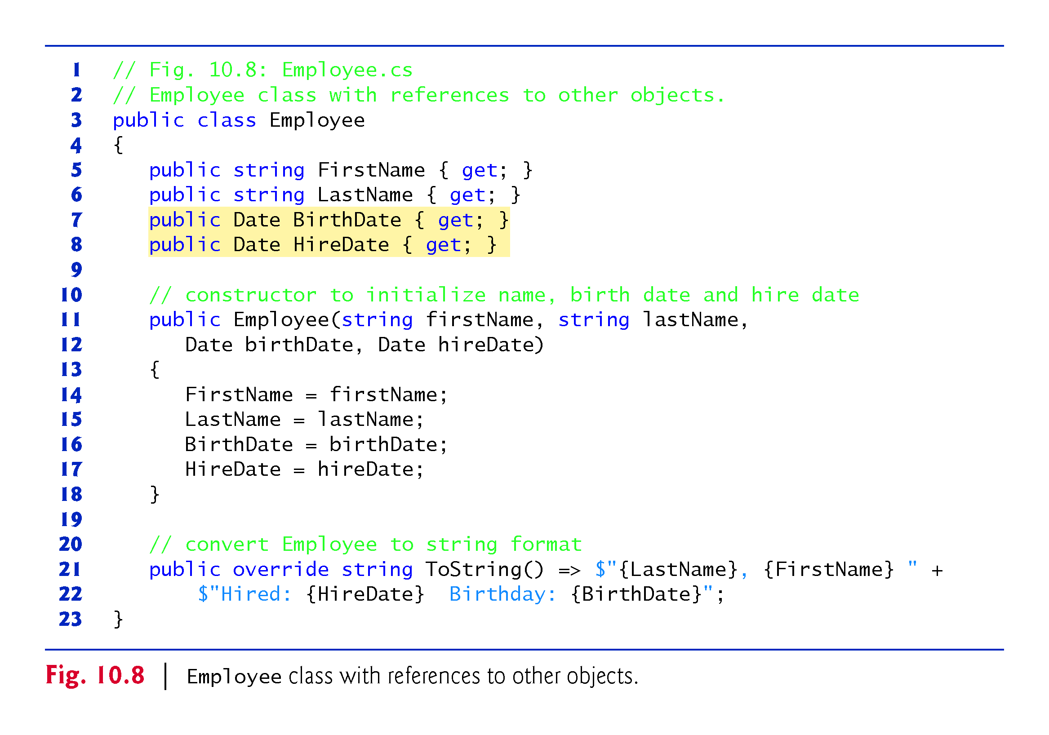

Slide 64
10.7.3 Class EmployeeTest
Class Employee­Test (Fig. 10.9) creates two Date objects to represent an Employee’s birthday and hire date, respectively.

Slide 65
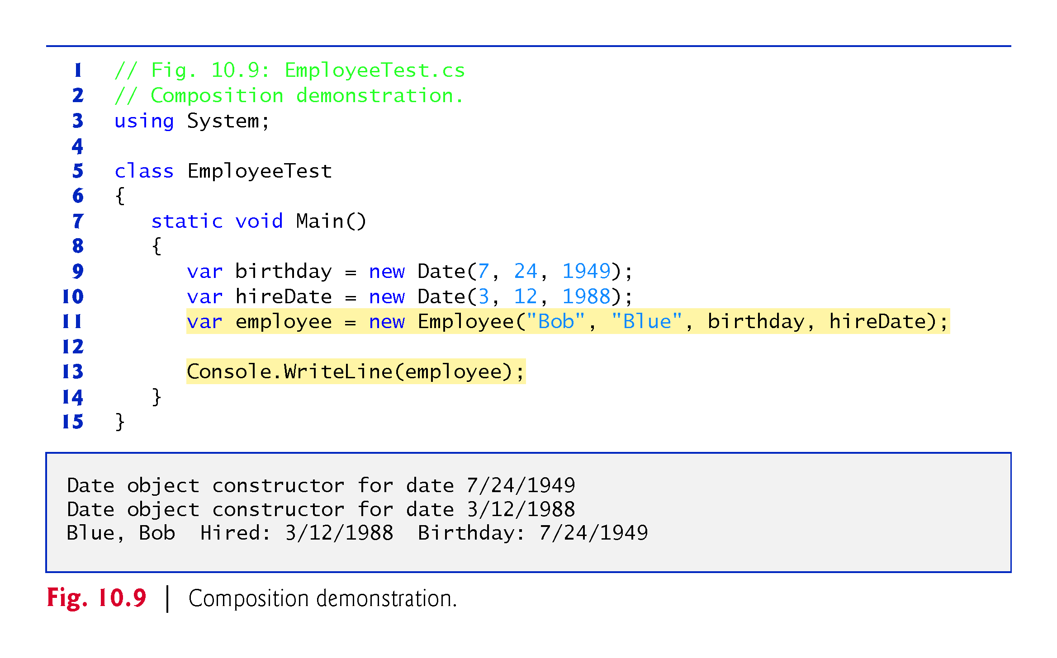

Slide 66
10.8 Garbage Collection and Destructors
Every object you create uses various system resources, such as memory.
In many programming languages, these system resources are reserved for the object’s use until they’re explicitly released by the programmer.
If all the references to the object that manages the resource are lost before the resource is explicitly released, it can no longer be released. This is known as a resource leak.

Slide 67
10.8 Garbage Collection and Destructors
The Common Language Runtime (CLR) uses a garbage collector to reclaim the memory occupied by objects that are no longer in use.
When there are no more references to an object, the object becomes eligible for destruction.
Every object has a destructor that’s invoked by the garbage collector to perform termination housekeeping before its memory is reclaimed.

Slide 68
10.8 Garbage Collection and Destructors (Cont.)
A destructor’s name is the class name, preceded by a tilde, and it has no access modifier in its header.
After an object’s destructor is called, the object becomes eligible for garbage collection—the memory for the object can be reclaimed by the garbage collector.
Memory leaks are less likely in C# than languages like C and C++ (but some can still happen in subtle ways).

Slide 69
10.8 Garbage Collection and Destructors (Cont.)
Other types of resource leaks can occur, for example if an app fails to close a file that it has opened.
A problem with the garbage collector is that it is not guaranteed to perform its tasks at a specified time. For this reason, destructors are rarely used.

Slide 70
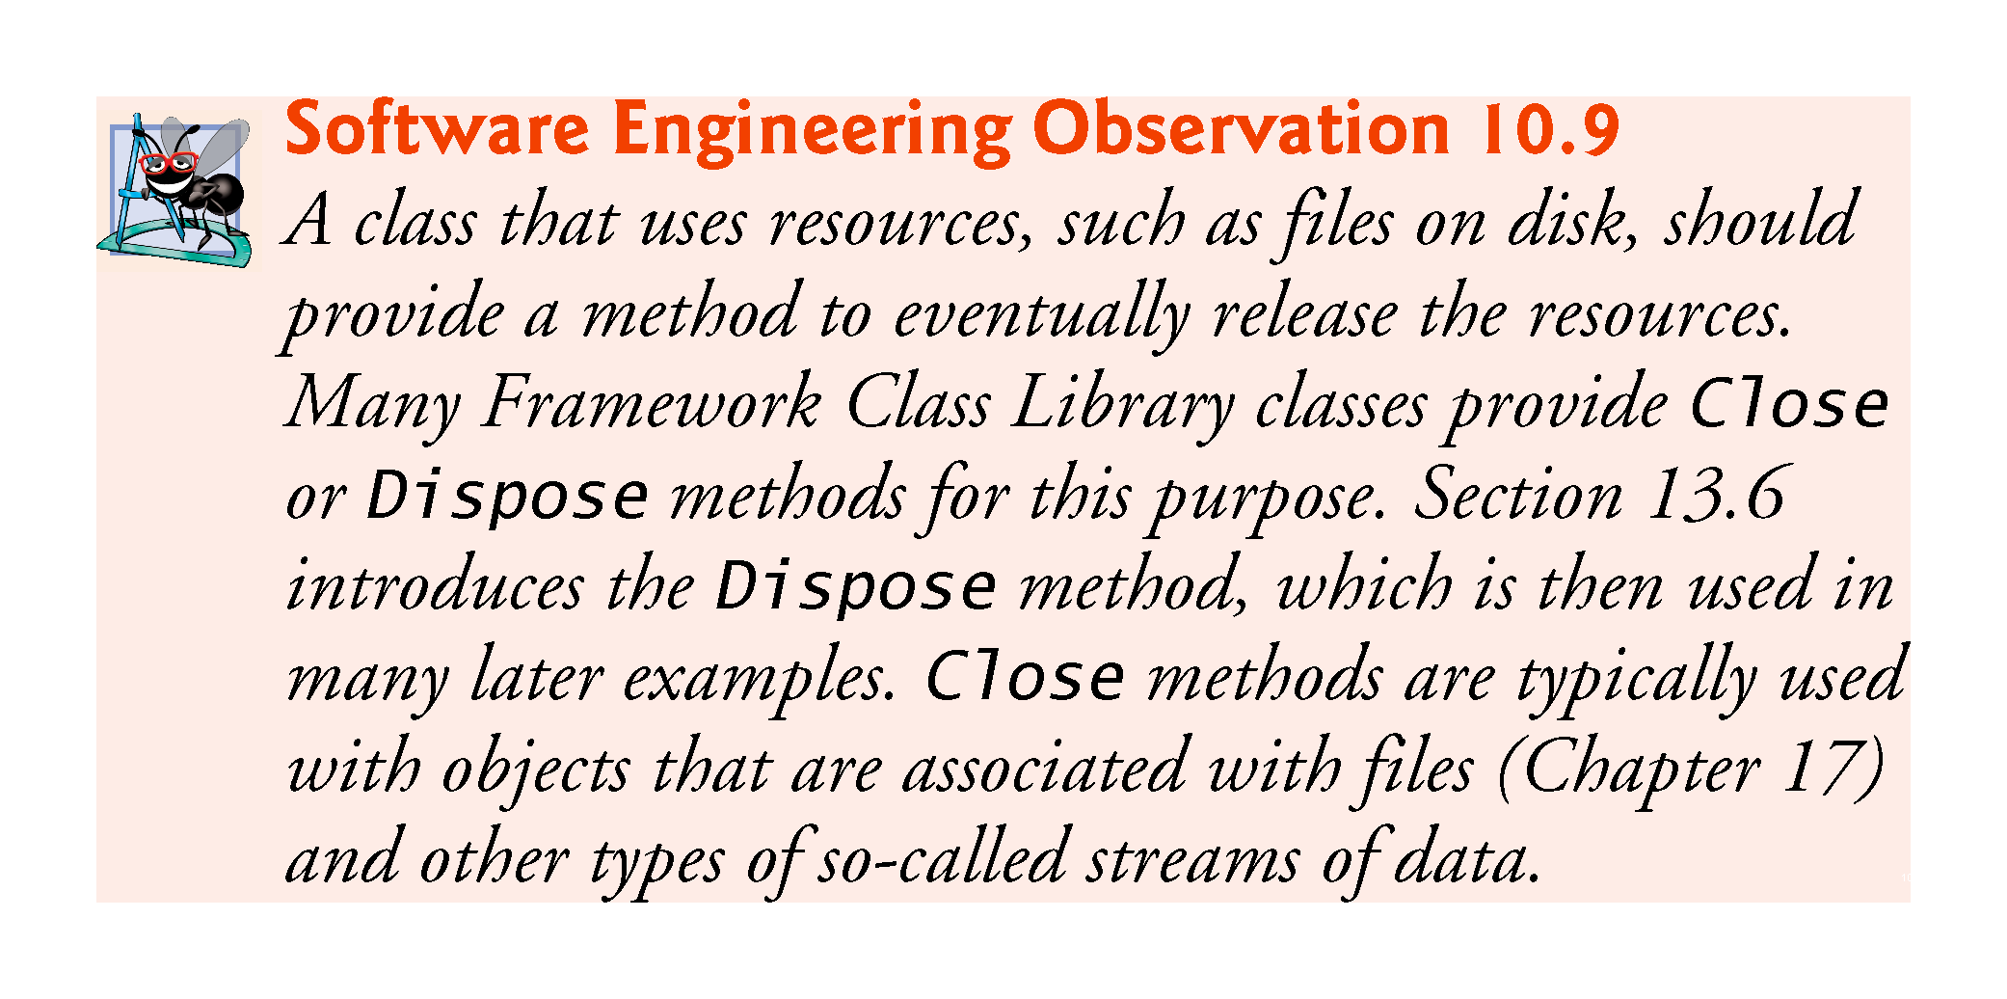

Slide 71
10.9 static Class Members
A static variable or property is used when only one copy of a particular variable should be shared by all objects of a class.
A static variable or property represents classwide information—all objects of the class share the same piece of data.
The declaration of a static variable or property begins with the keyword static.

Slide 72


Slide 73
10.9 static Class Members (Cont.)
The scope of a static variable is the body of its class.
A class’s public static members can be accessed by qualifying the member name with the class name and the member access (.) operator, as in Math.PI.
A class’s private static class members can be accessed only through the class’s methods and properties.
To access a private static member from outside its class, a public static method or property can be provided.

Slide 74
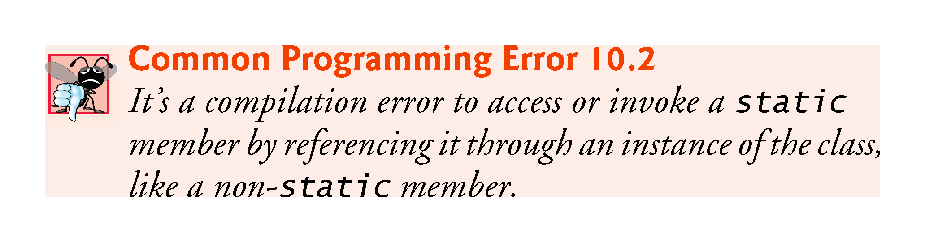

Slide 75
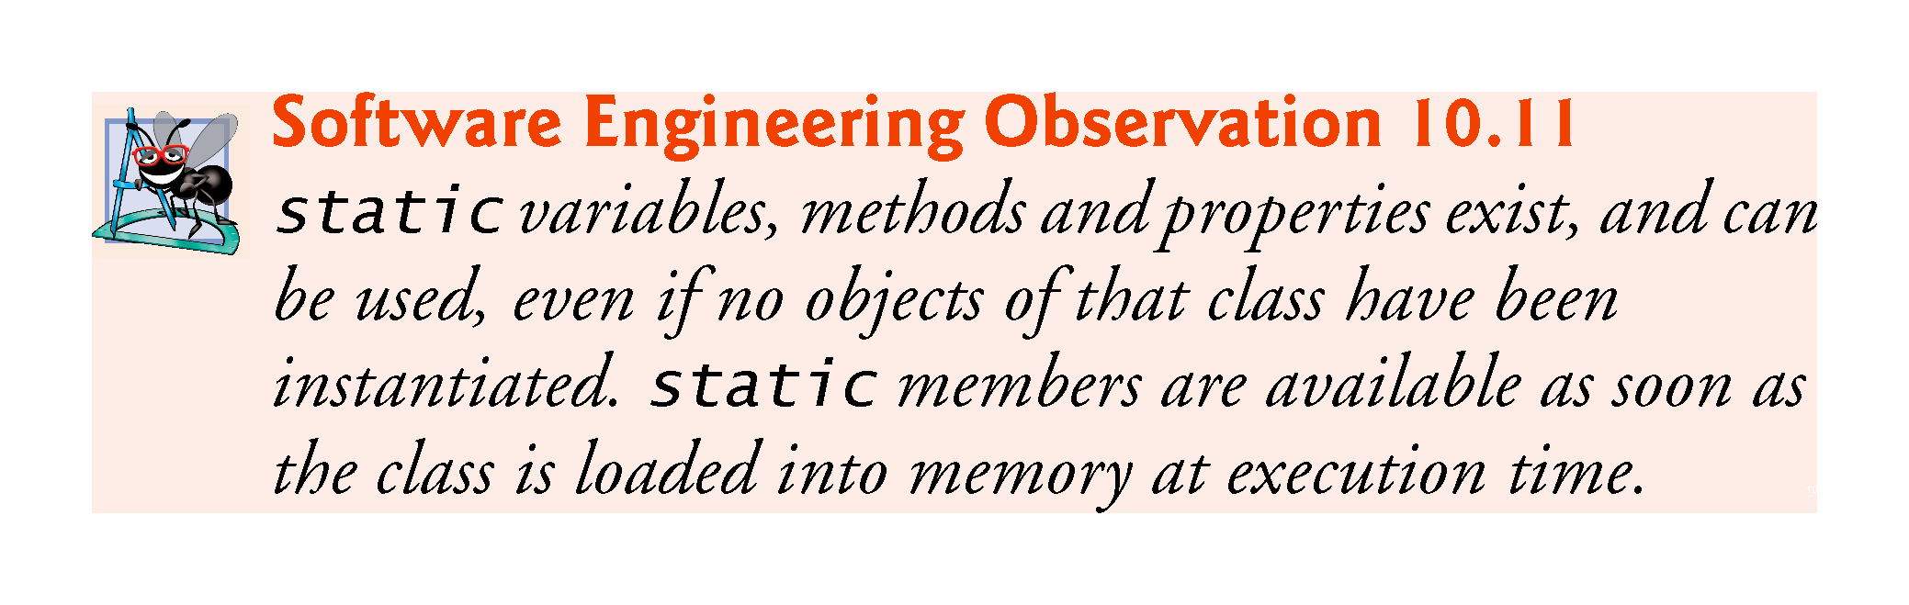

Slide 76
10.9 static Class Members (Cont.)
A static method (or property) cannot access non-static class members directly, because a static method (or property) can be called even when no objects of the class exist.
For the same reason, this cannot be used in a static method—the this reference always refers to a specific object of the class.
When a static method is called, it does not know which object to manipulate and there might not be any objects of its class in memory.

Slide 77
10.9 static Class Members (cont.)
Class Employee declares private static auto-implemented property Count to maintain a count of the number of Employee objects that have been created.
Count’s set accessor is private, because only class Employee should be able to modify Count’s value.
Count is a static auto-implemented property, so the compiler creates a corresponding private static variable that Count manages.
When you declare a static variable and do not initialize it, the compiler initializes it to the type’s default value (in this case, 0).

Slide 78
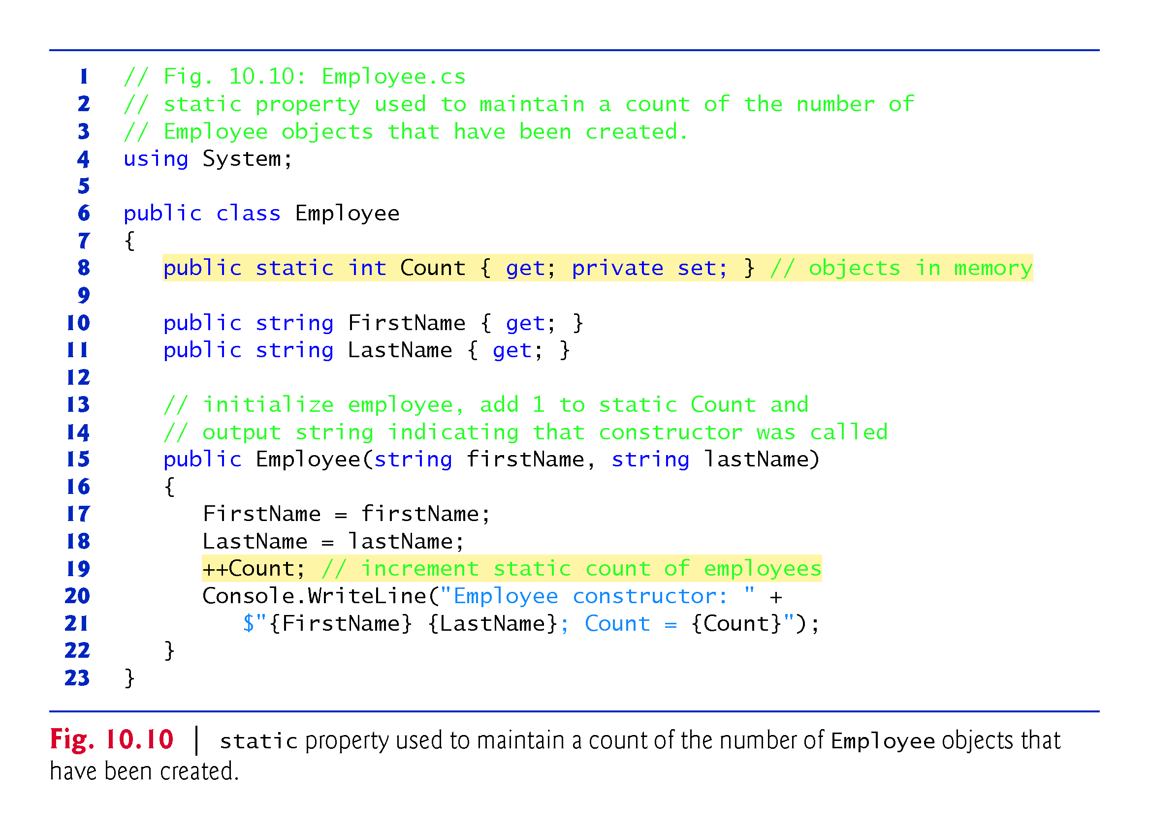

Slide 79
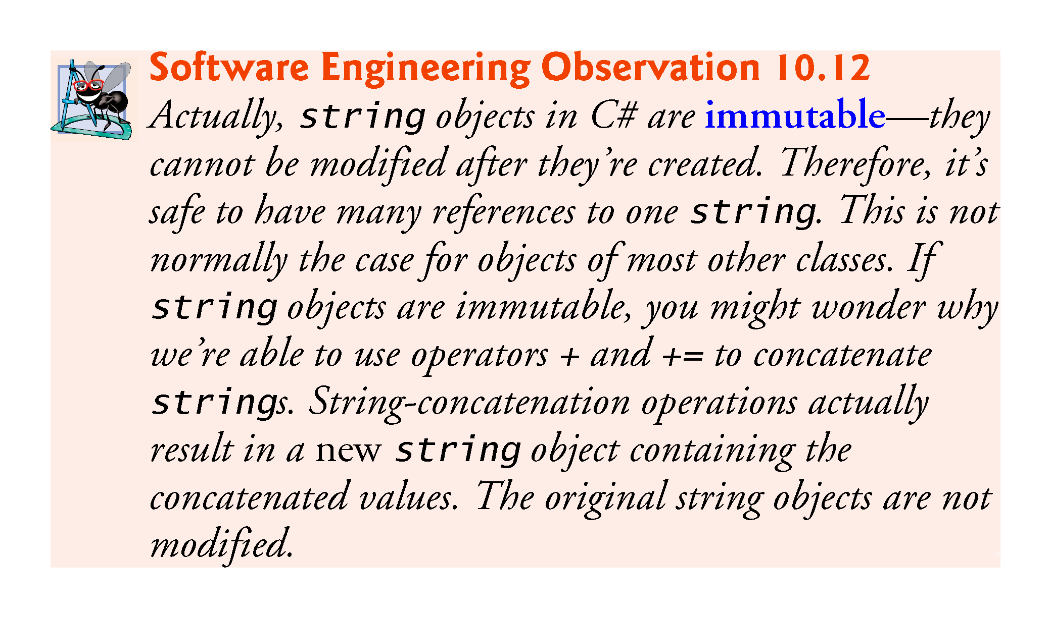

Slide 80
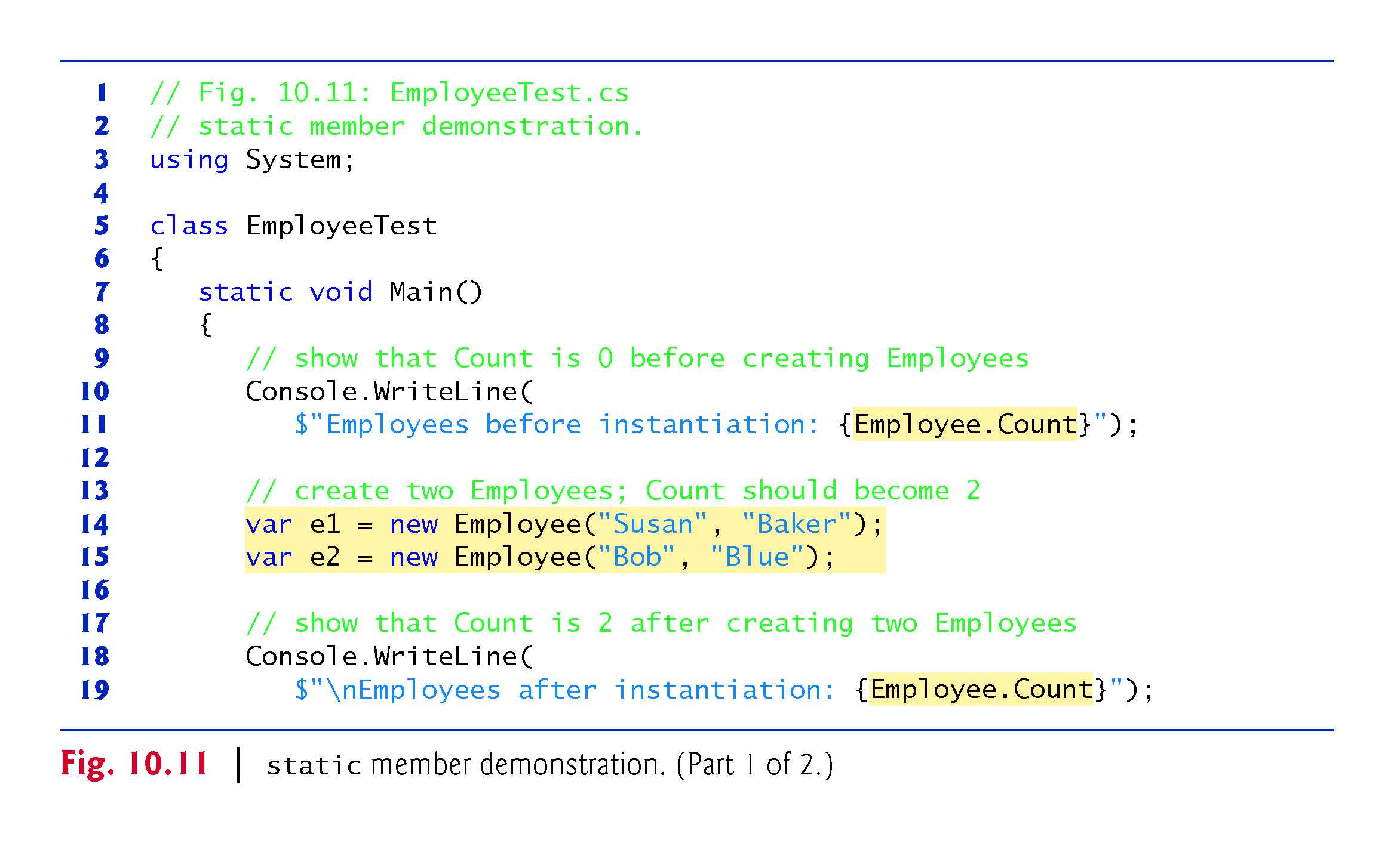

Slide 81
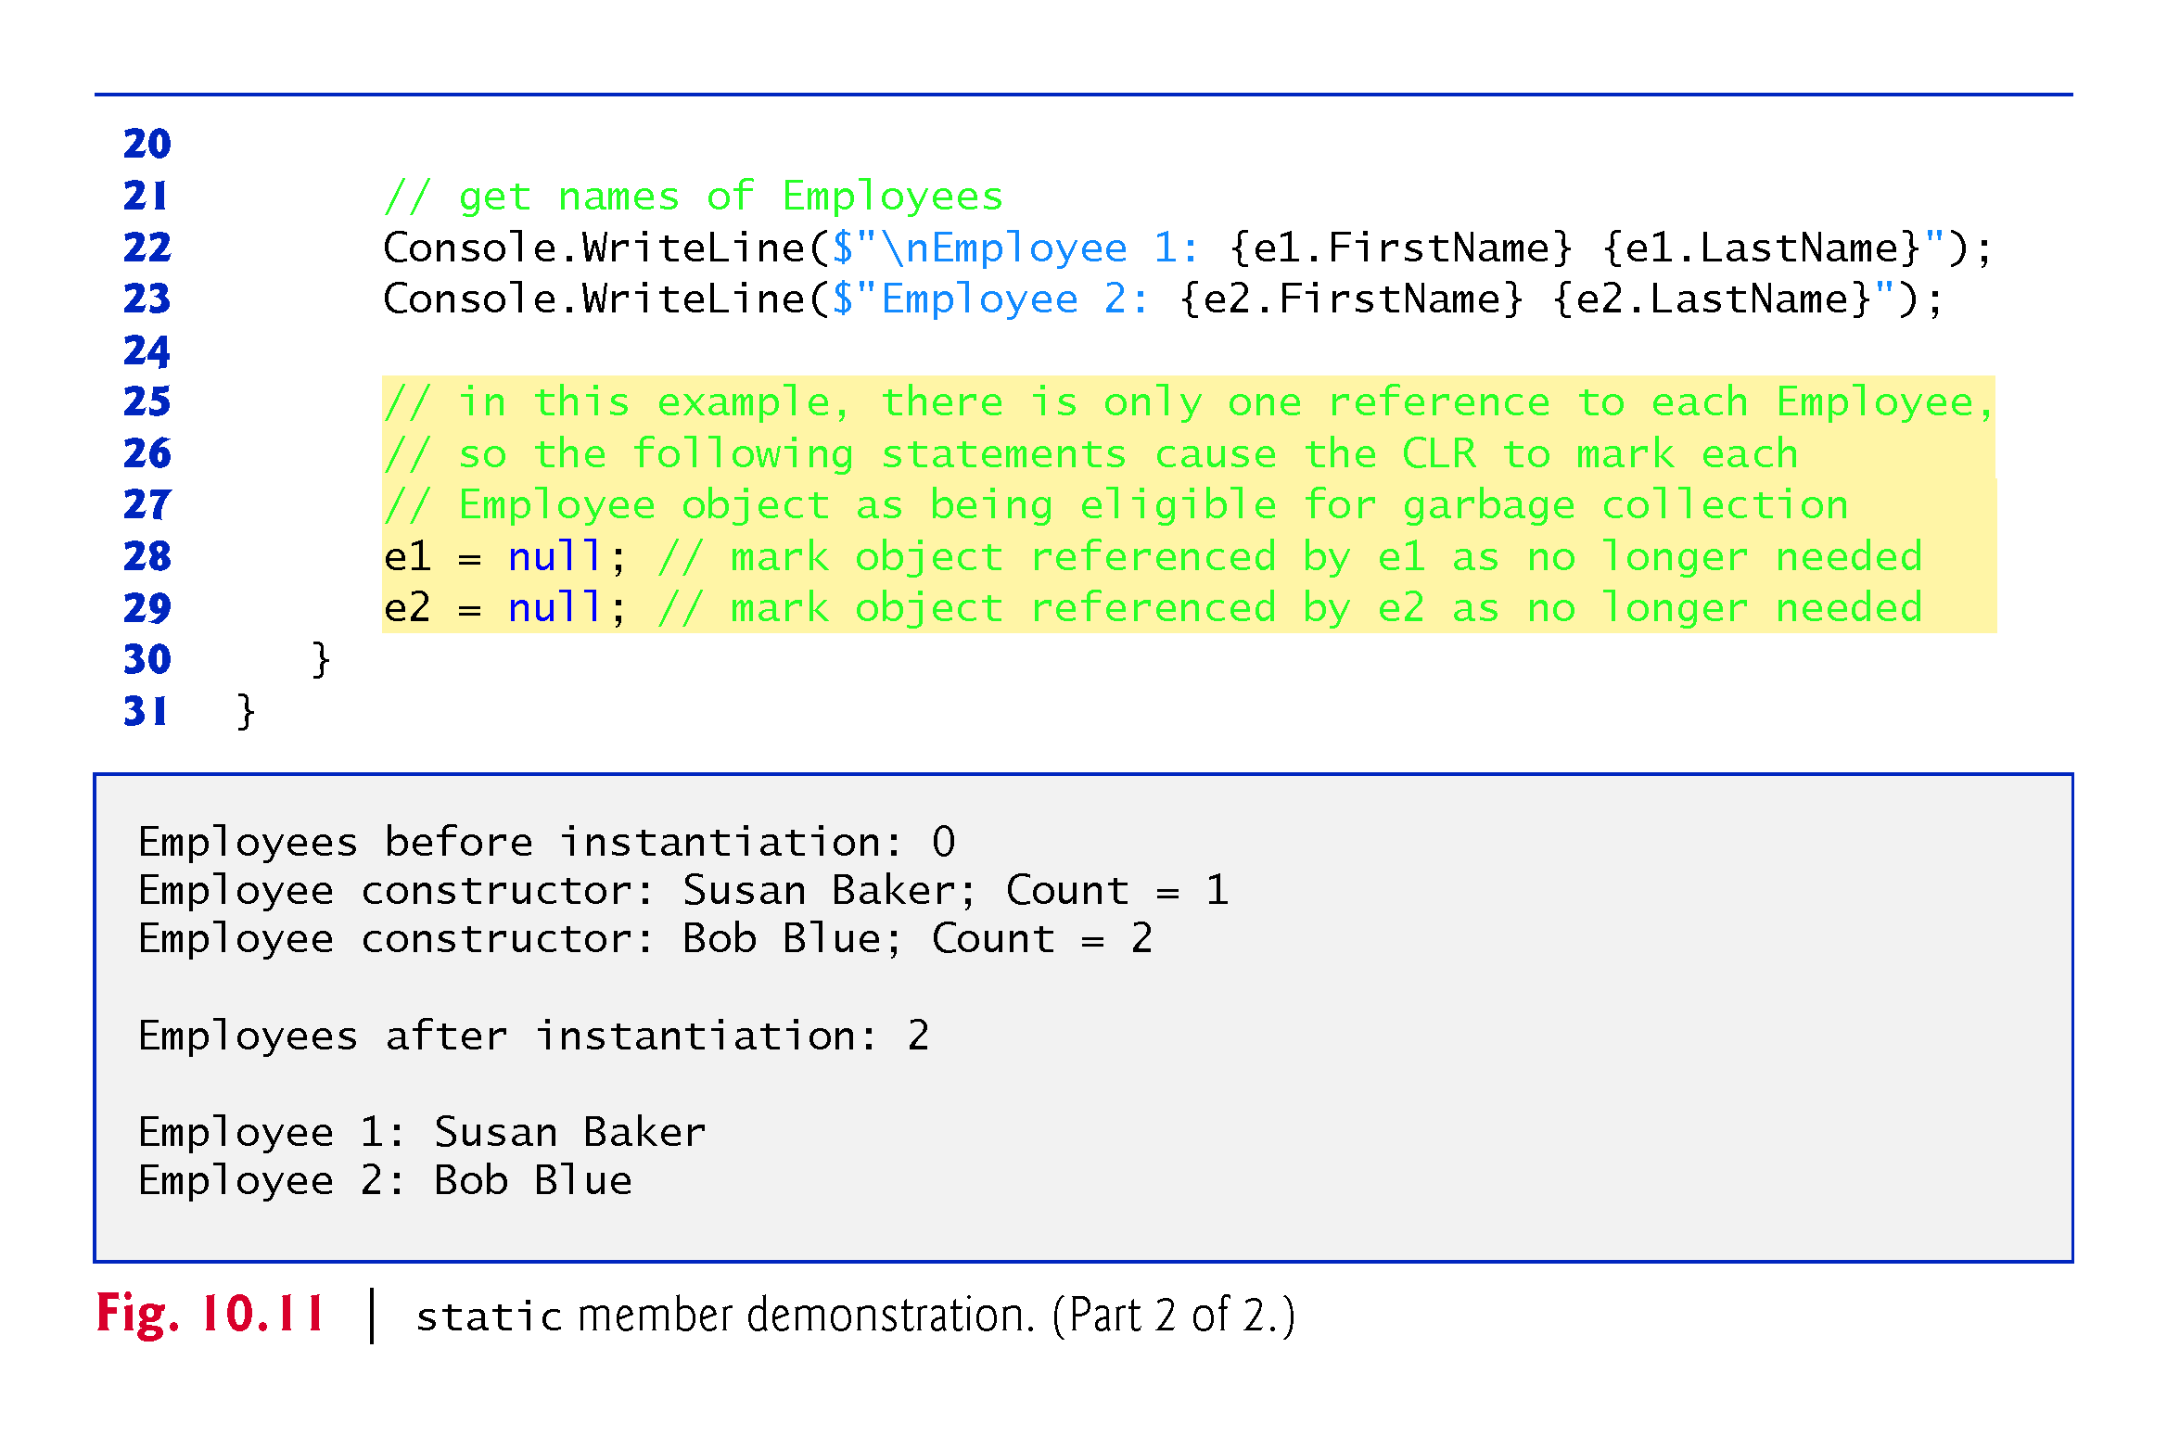

Slide 82
10.10 readonly Instance Variables
The principle of least privilege states that code should be granted the amount of privilege and access needed to accomplish its designated task, but no more.
Constants declared with const must be initialized to a constant value when they’re declared.
C# provides keyword readonly to specify that an instance variable of an object is not modifiable and that any attempt to mod­ify it after the object is constructed is an error.
A readonly variable’s identifier uses Pascal Case by convention.

Slide 83
10.10 readonly Instance Variables (Cont.)
Although readonly instance variables can be initialized when they’re declared, this isn’t required.
A readonly variable should be initialized by each of the class’s constructors or in the variable’s declaration.
Each constructor can assign values to a readonly instance variable multiple times—the variable doesn’t become unmodifiable until after the constructor completes execution.
If a constructor does not initialize the readonly variable, the variable uses the same default value as any other instance variable.

Slide 84
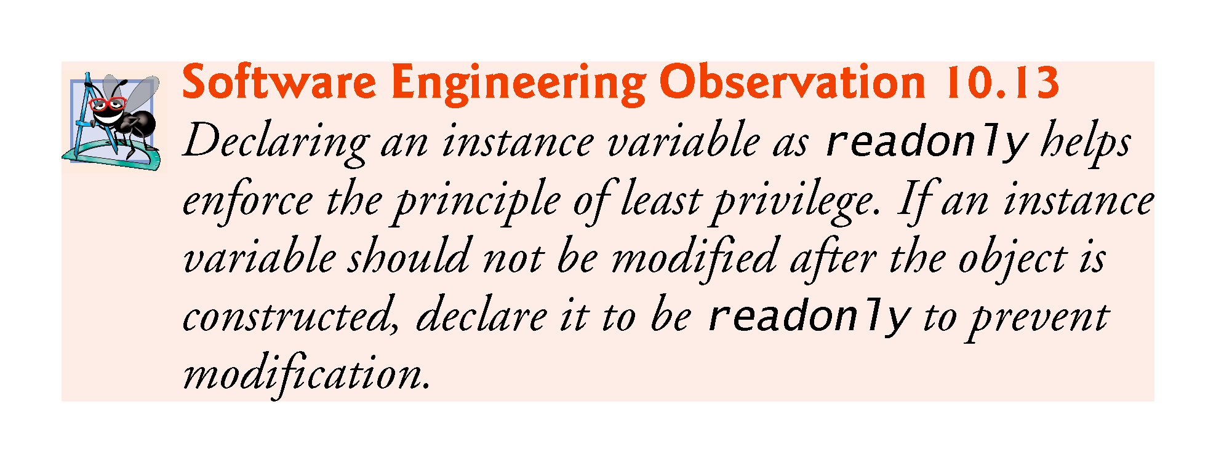

Slide 85
10.10 readonly Instance Variables (Cont.)
const members must be assigned values at compile time.
const members can be initialized only with other constant values, such as integers, string literals, characters and other const members.
Constant members with values that cannot be determined at compile time—such as constants that are initialized with the result of a method call—must be declared with keyword readonly, so they can be initialized at execution time.
Variables that are readonly can be initialized with more complex expressions, such as an array initializer or a method call that returns a value or a reference to an object.

Slide 86
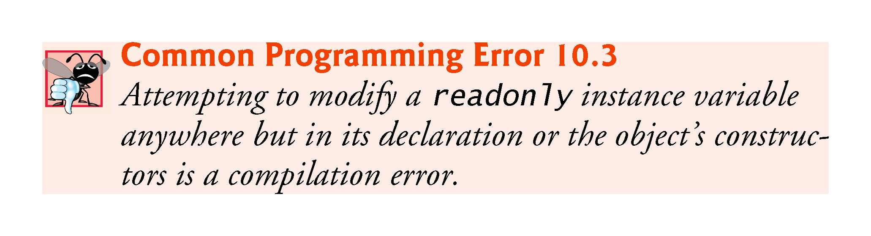

Slide 87
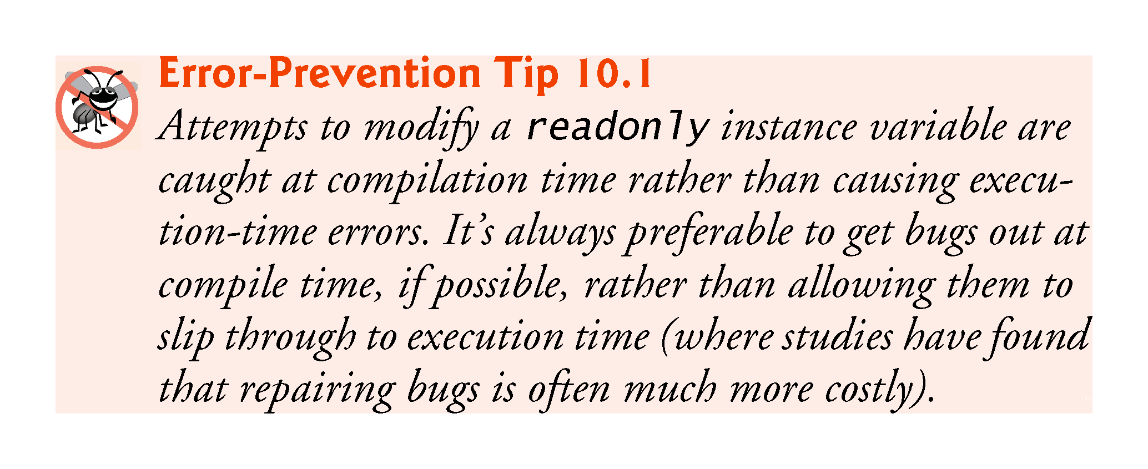

Slide 88
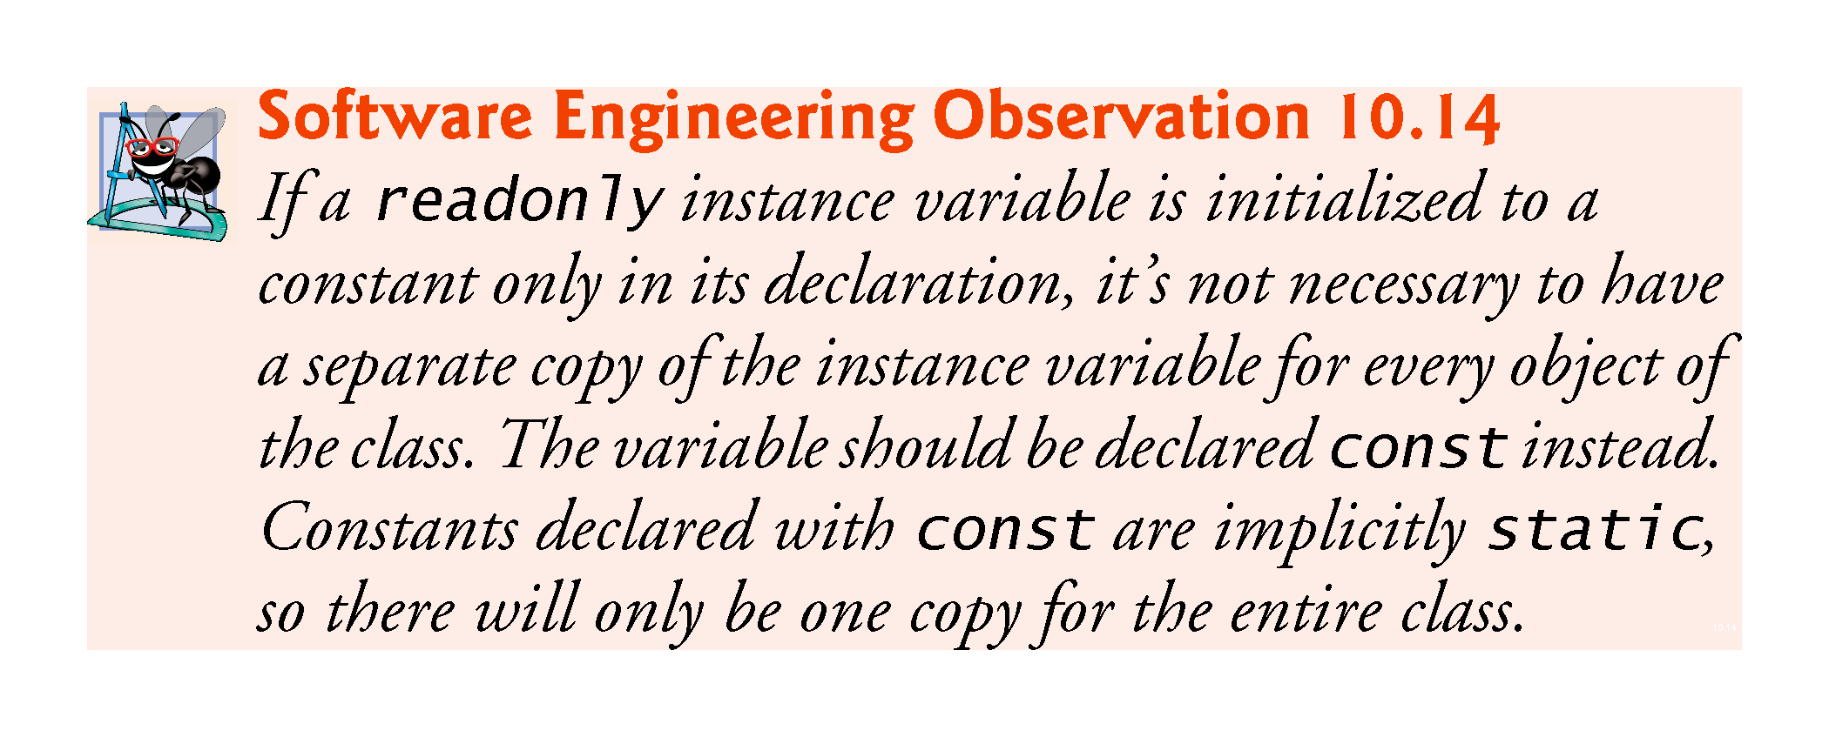

Slide 89
10.10 readonly Instance Variables (Cont.)
C# 6 Getter-Only Auto-Implemented Properties and readonly
When an auto-implemented property has only a get accessor, the property can be used only to read the value, so the compiler implicitly declares the corresponding private instance variable as readonly.
Getter-only auto-implemented properties can be initialized in their declarations or in constructors.

Slide 90
10.11.1 Using the Class View Window
The Class View displays the fields, methods and properties for all classes in a project.
Select View > Class View to display the Class View as a tab in the same position within the IDE
Figure 10.12 shows the Class View for the Time1 project of Fig. 10.1 (class Time1) and Fig. 10.2 (class TimeTest1).

Slide 91


Slide 92
10.11.1 Using the Class View Window
The view follows a hierarchical structure, with the project name as the root.
When a class is selected, its members appear in the lower half of the window.
public methods are indicated by purple boxes
public properties are indicated by wrench icons
If a class has any private members, those members’ icons contain small padlocks.

Slide 93
10.11.2 Using the Object Browser
You can use the Object Browser to learn about the functionality provided by a specific class.
To open the Object Browser, select View > Object Browser.
Figure 10.13 depicts the Object Browser when the user navigates to the Math class in namespace System in the assembly mscorlib.dll (Microsoft Core Library).

Slide 94


Slide 95
10.11.2 Using the Object Browser
The Object Browser lists all methods provided by class Math in the upper-right frame.
If you click the name of a member in the upper-right frame, a description of that member appears in the lower-right frame.
The Object Browser can be a quick mechanism to learn about a class or one of its methods.

Slide 96
10.12 Object Initializers
Object initializers allow you to create an object and initialize its public properties (and public instance variables, if any) in the same statement.
This can be useful when a class does not provide an appropriate constructor to meet your needs, but does provide a constructor that can be called with no arguments and properties that you can use to set the class’s data
new Time2 is immediately followed by an object-initializer list—a comma-separated list in curly braces ({ }) of properties and their values.

Slide 97
10.12 Object Initializers (Cont.)
Each property name can appear only once in the object-initializer list.
The object initializer executes the property initializers in the order in which they appear.

Slide 98
10.13 Operator Overloading; Introducing struct
You can create operators that work with objects of your own types—via a process called operator overloading.
You can overload most operators.

Slide 99
10.13.1 Creating Value Types with struct
C#’s simple numeric types are value types.
C#’s simple types like int and double are actually aliases for struct types—an int is defined by the struct System.Int32, a long by System.Int64, a double by System.Double and so on.
Operator overloading also can be applied to classes.

Slide 100
10.13.1 Creating Value Types with struct
When to Declare a struct Type
Microsoft recommends using classes for most new types, but recommends a struct if:
the type represents a single value
the size of an object is 16 bytes or smaller
For the complete list of struct recommendations, see
https://msdn.microsoft.com/library/ms229017

Slide 101
10.13.2 Creating Value Types with struct
Value type ComplexNumber (Fig. 10.14) overloads the plus (+), minus (-) and multiplication (*) operators to enable programs to add, subtract and multiply instances of class ComplexNumber using common mathematical notation.

Slide 102


Slide 103


Slide 104


Slide 105
10.13.2 Creating Value Types with struct
Unlike a class, you cannot define a parameterless constructor for a struct.
The compiler always provides a default constructor that initializes the struct’s instance variables to their default values.
structs cannot specify initial values in instance variable or property declarations.

Slide 106
10.13.2 Creating Value Types with struct
Keyword operator, followed by an operator symbol (such as +), indicates that a method overloads the specified operator.
Overloaded operator methods are required to be public and static.
Methods that overload binary operators must take two arguments—the first is the left operand and the second is the right operand.

Slide 107


Slide 108


Slide 109


Slide 110
10.13.3 Class ComplexTest
Class ComplexTest (Fig. 10/15) demonstrates the overloaded operators for adding, subtracting and multiplying ComplexNumbers.

Slide 111


Slide 112


Slide 113
10.14 Time Class Case Study: Extension Methods
You can use extension methods to add functionality to an existing type without modifying the type’s source code.
LINQ’s capabilities are implemented as extension methods.
Figure 10.16 uses extension methods to add two new methods to class Time2 (Section 10.5)—DisplayTime and AddHours.

Slide 114


Slide 115


Slide 116


Slide 117


Slide 118
10.14 Time Class Case Study: Extension Methods (Cont.)
The this keyword before a method’s first parameter notifies the compiler that the method extends an existing class.
The type of the first parameter specifies the type of object on which you can call the extension method.
Extension methods must be defined as static methods in a static class.
A static class can contain only static members and cannot be instantiated.

Slide 119
10.14 Time Class Case Study: Extension Methods (Cont.)
When you call an extension method, you do not provide an argument for the first parameter.
The compiler implicitly passes the object that calls the method as the extension method’s first argument.
This allows you to call the extension method as if it were an instance method.
IntelliSense displays extension methods with the class’s instance methods and identifies them with a similar icon that also has a down arrow.

Slide 120
10.14 Time Class Case Study: Extension Methods (Cont.)
Line 23 uses both extension methods (DisplayTime and AddHours) in a single statement to add 15 hours to the original myTime and display the result in the console.
Multiple method calls in the same statement are known as cascaded method calls.
When a method returns an object, you can follow the method call with a member access operator (.) then call a method on the object that was returned.
The methods are called from left to right.

Slide 121
10.14 Time Class Case Study: Extension Methods (Cont.)
You can call an extension method via its fully qualified name by using the name of the class in which the extension method is defined (TimeExtensions), followed by the member access operator (.), the method name (DisplayTime) and its argument list.
When using the fully qualified method name, you must specify an argument for extension method’s first parameter.

Slide 122
10.14 Time Class Case Study: Extension Methods (Cont.)
If a type for which you declare an extension method already defines an instance method with the same name and a compatible signature, the instance method will shadow (i.e., hide) the extension method.
If a predefined type is later updated to include an instance method that shadows an extension method, the compiler does not report any errors and the extension method does not appear in IntelliSense.

